Slide 1
Neutrality in Question: Weaving Diverse Experiences into New Library Values
Community Conversation
Emily Jaeger-McEnroe
CAPAL 2025

Slide 2
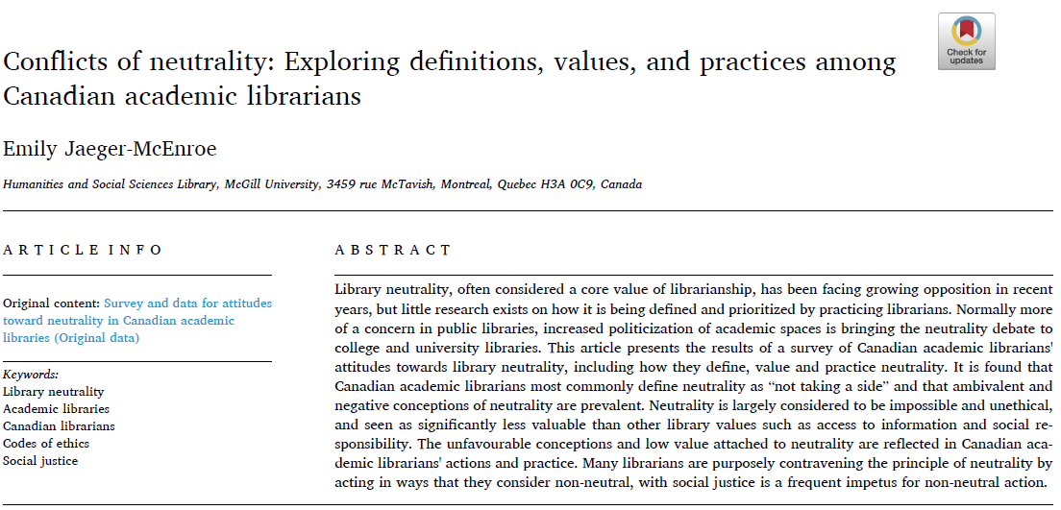
Notes:
Look up number of respondents again --- 179

Slide 3
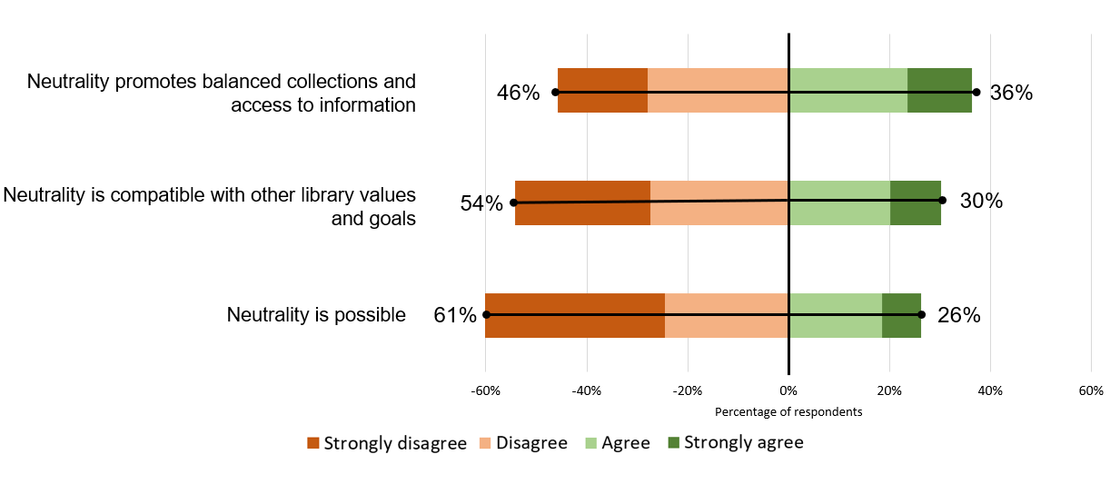

Slide 4
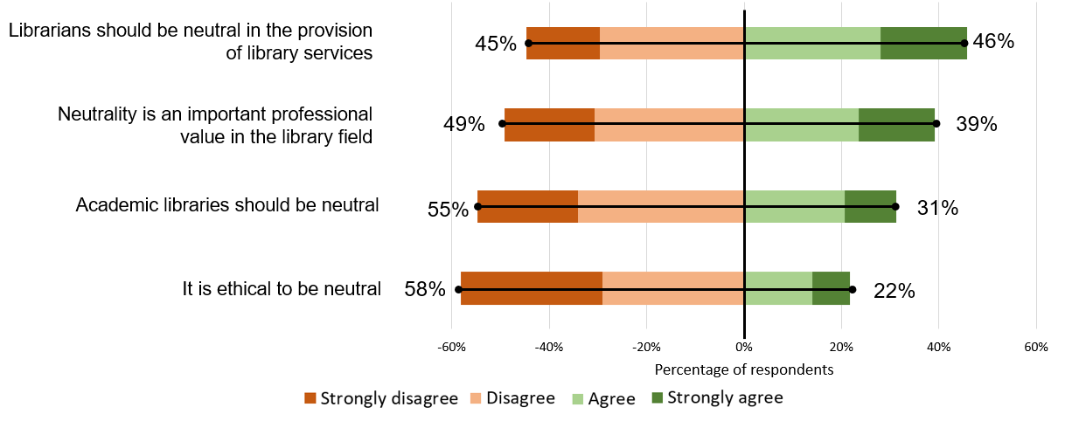

Slide 5
Negative on neutrality
33% of survey respondents expressed some negative feelings towards neutrality in their free-text answers
Compare to 75% supportive (Scott & Saunders, 2020) or 25% with negative feelings towards it (Lumley, 2020; VanScoy, 2021) and prevalent “ambivalence” (Macdonald & Birdi, 2020)

Slide 6
Are you negative, positive or ambivalent about neutrality in libraries?
Discussion

Slide 7
Scenario Questions
Respondents were asked if each of the following scenarios represented a position of neutrality, and whether they would take said action.
Allowing a group with white supremacist views to rent a library room for a public speaking event
Buying books representing both pro-life and pro-choice positions
Celebrating Indigenous Awareness week with a curated display on decolonization
Displaying pride flags (i.e. LGBTQ Rainbow Flag, Trans Pride Flag, etc.) at the reference desk
Helping a user find information about building bombs

Slide 8
Neutrality and Action
If everyone acted perfectly neutrally, we would expect people’s judgements about the neutrality of a scenario and if they would do it to line up :
Not Neutral
=
Don’t do it
Neutral
=
Do it

Slide 9
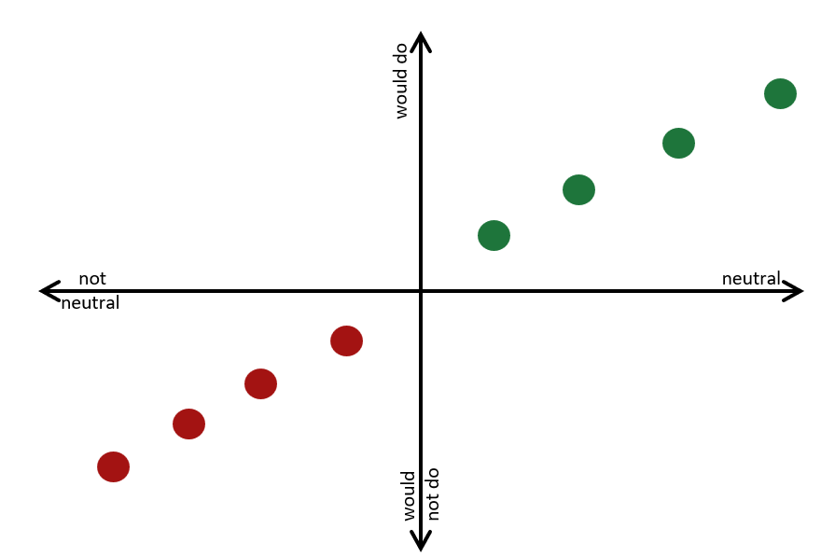
Neutrality and Action

Slide 10
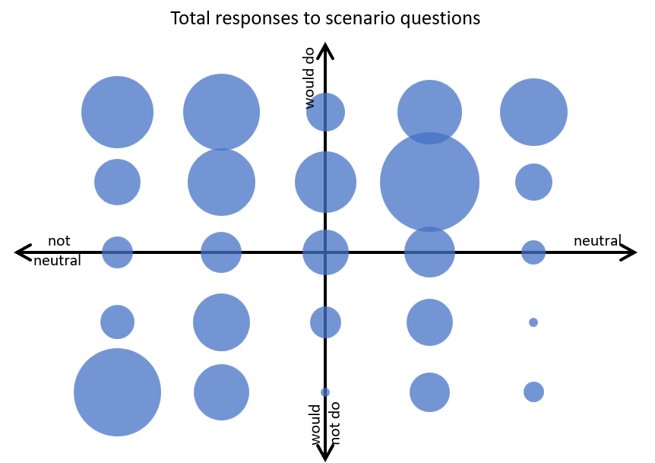
Neutrality and Action

Slide 11
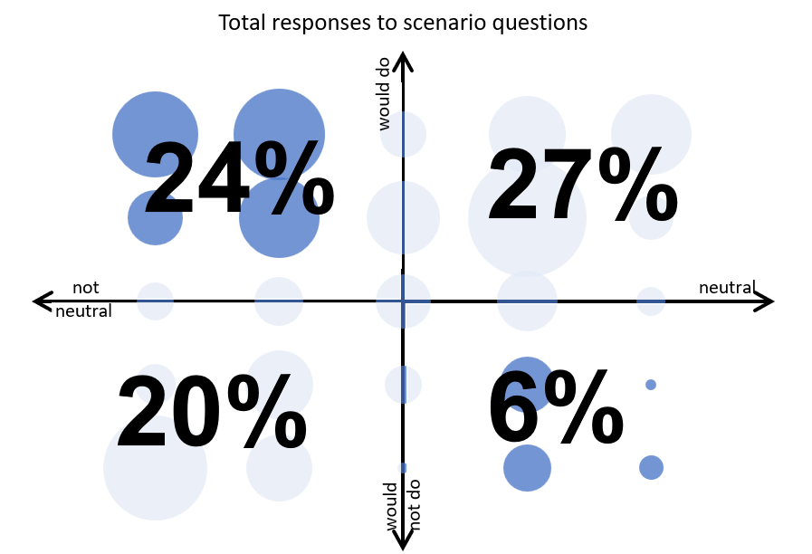
Neutrality and Action

Slide 12
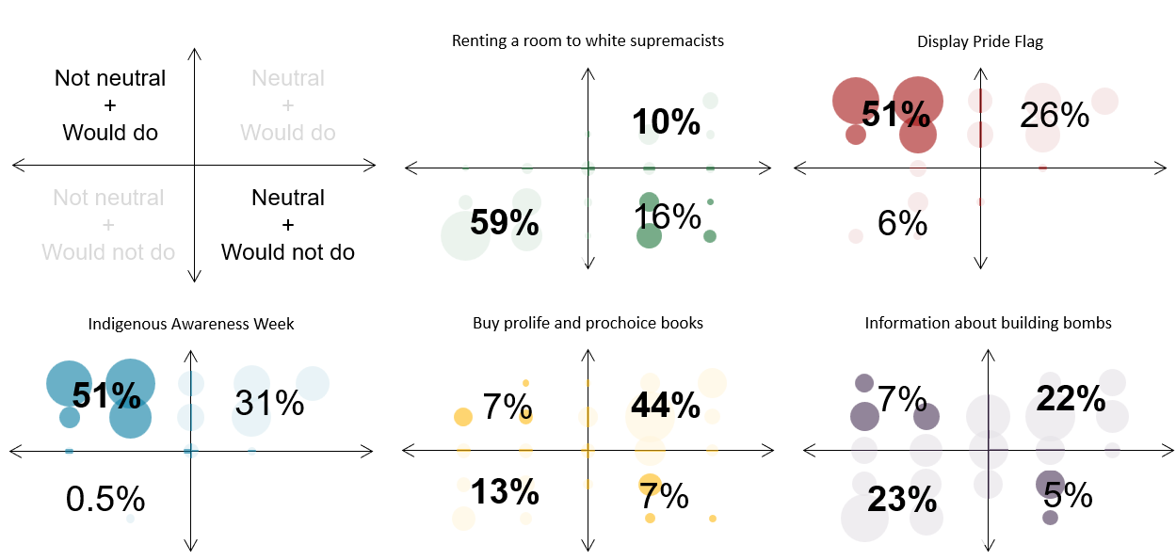
Neutrality and Action
Notes:
Pairs with free text comments where many (look up number?) respondents directly stated choose to act non-neutrally to enact social justice/EDIA

Slide 13
Have you acted non-neutrally?
Does considering a specific situation change your positive/ambivalent/negative feelings toward neutrality?

Slide 14
Social Justice & Neutrality
Library school, codes of ethics and most LIS literature pose neutrality as a requirement.
If critiques of neutrality are not part of library science curricula, where is librarians’ resistance to neutrality coming from?

Slide 15
Critical Theory
Analyses and challenges systemic power relations in society. Knowledge, truth, and social structures are shaped by power dynamics between dominant and oppressed groups.
Marxism
Feminism
Queer theory
Critical race theory
Postcolonialism
Disability studies
Etc…

Slide 16
Critical Theory & Librarians
2/3
1/3
Familiar with critical theory
Not explicitly familiar with critical theory
79%
29-54%
Critical theory plays a role in their practice
Issues affecting marginalized groups impact their practice

Slide 17
Critical Theory & Librarians
50%
Library school did not inform their ideas of critical theory
14%
First encountered critical theory in library school

Slide 18
What made you critical of library neutrality?
Community, research, work, lived experiences?

Slide 19
References
Jaeger-McEnroe, E. (2024). Conflicts of neutrality: Exploring definitions, values, and practices among Canadian academic librarians. The Journal of Academic Librarianship, 50(6). https://doi.org/10.1016/j.acalib.2024.102958
Lumley, R. M. (2020). The academic library and social justice: Exploring librarian attitudes at one HSI. Journal of Hispanic Higher Education, 19(4), 472-491. https://doi.org/10.1177/1538192718823179
Macdonald, S., & Birdi, B. (2020). The concept of neutrality: A new approach. Journal of Documentation, 76(1), 333-353. https://doi.org/10.1108/JD-05-2019-0102
Schroeder, R., & Hollister, C. V. (2014). Librarians’ views on critical theories and critical practices. Behavioral & Social Sciences Librarian, 33(2), 91-119. https://doi.org/10.1080/01639269.2014.912104
Scott, D., & Saunders, L. (2020). Neutrality in public libraries: How are we defining one of our core values? Journal of Librarianship and Information Science, 53(1), 153-166. https://doi.org/10.1177/0961000620935501
VanScoy, A. (2021). Using Q methodology to understand conflicting conceptualizations of reference and information service. Library & Information Science Research, 43(3). https://doi.org/10.1016/j.lisr.2021.101107

