Slide 1





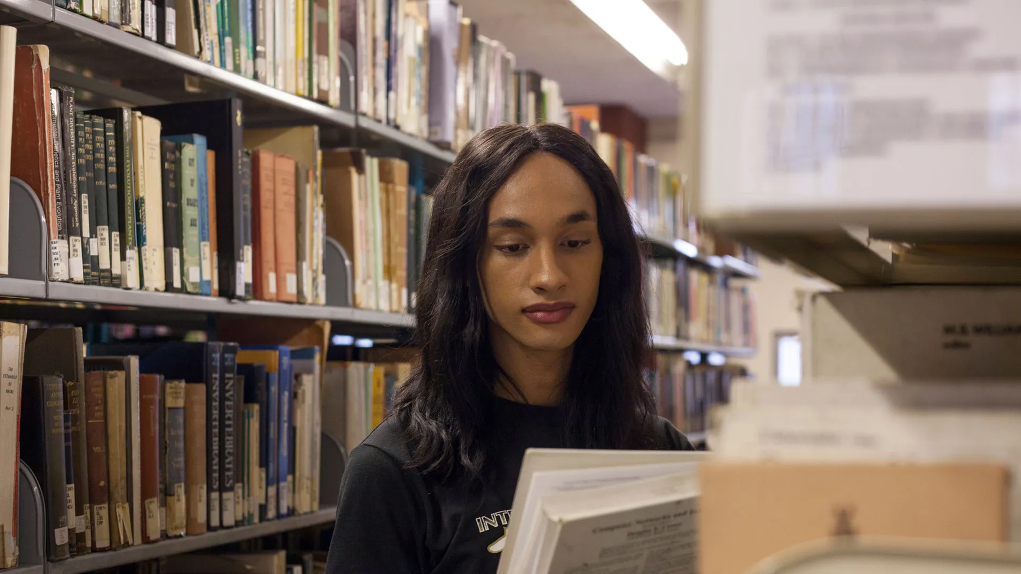

Abstract, Immaterial, Emotional, Undervalued:
Interrogating Trans and Gender Diverse Labour in Libraries
CAPAL 2025

Slide 2




Who Am I?
  Agender, transmasculine
  Queer
  Autistic, invisibly disabled
  White settler
Magnus Berg (they/he)
Digital Scholarship Librarian
University of Toronto, Mississauga
Notes:
Hi everyone, my name is Magnus Berg, I am a Digital Scholarship Librarian at the University of Toronto, Mississauga.
My positionality is particularly important for what I'm going to be covering in my presentation. I am agender and transmasculine. I came out as trans a decade ago when the political landscape was very different. As a result I have a unique vantage point as someone who has navigated this field as a trans person for the entirety of my career. I am queer, autistic and invisibly disabled. I grew up in a middle class household in Alberta on Treaty 7 territory and am an uninvited guest on this land.

Slide 3




What This Presentation is Not
  A trans 101 session
  An examination of DEI intiatives in libraries
  Providing recommendations on how libraries can be “inclusive”
  Examining the experiences of trans/gender diverse patrons, except as how they relate to trans/gender diverse labour
What This Presentation Is
  An indictment of library administrations and leadership
  A critical examination of how trans/gender diverse library workers are marginalized, subjugated, exploited, and expected to assimilate
  An opportunity to reflect on how you and your library approach and treat trans/gender diverse colleagues and employees
Notes:
I started doing the research for this presentation and a related article five years ago. Part of why it took me so long to complete is that 1) scholarship on trans labour in libraries was practically non-existent when I started and 2) reading the testimonies of other trans library workers was so distressing and reminiscent of my own experiences that I had to take breaks just to get through it. To those of you that may be trans/gender diverse youself a content warning that I will be talking about workplace experiences that may be distressing to you. Also, please accept my apologies as much of this presentation is aimed at our cis colleagues.
I am going to be talking about some uncomfortable topics today. As my presentation title may imply, this is not going to be a feel good session on trans inclusion in libraries. I will not be going over any Trans 101 topics. There is an expectation that you will do your own research on any community terminology you may be unfamiliar with during this session. I will also not be exploring DEI initiatives in libraries or providing recommendations on how libraries can be more inclusive.
What I will be exploring is the ways that trans/gender diverse library workers are marginalized, subjugated, exploited and expected to assimilate into their institutions. As I'll demonstrate, what is experienced by trans/gender diverse library workers is systemic rather than solely individual or interpersonal. As such, I intend to indict library administrators and leaders in the field for their complicity in reifying and perpetuating inequity. For the attendees here today, I invite you to take this presentation as an opportunity to reflect on how you and your library treat trans/gender diverse colleagues and employees. I invite you to take notice of the barriers that trans/gender diverse workers face that you do not. and I invite you to question why you have few, if any, trans/gender diverse colleagues in your library and whether they are compensated or have stable employment commensurate with their experience compared to your other colleagues.

Slide 4



My Framework
This research is based on the following:
  Available statistics on salary and employment for trans/gender diverse workers in general and library workers in particular
  Published testimony from trans/gender diverse library workers on their experiences at work
  My own experience as a trans librarian
  Marxist Autonomist theory
  Trans theory/other critical theory
Notes:
My research is based on a combination of available statistics on salary, employment and workplace experiences of trans/gender diverse workers within and without libraries. This is paired with published testimony from trans/gender diverse library workers and my own experience as a trans librarian.

Slide 5
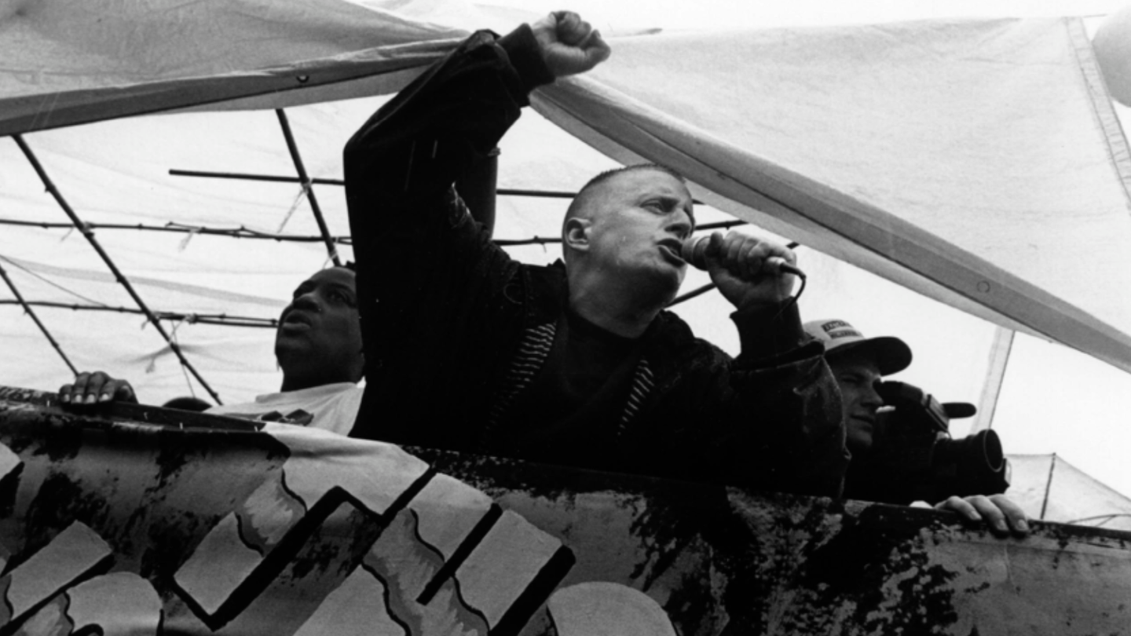

Let’s Talk About Marxism
Marxist Autonomist theory:
  Library labour is a form of immaterial labour
  Library labour does not interact with capital owners in the same way it does in the private sector
  Labour is still subordinate to, and subjugated by, the power of the institution’s administration
  Library administrators are workers, but collectively create an apparatus that subjugates and exploits the labour of their fellow workers
  Libraries do not exist outside of capitalist structures (Nicholson, 2022; Popowich, 2019)
Leslie Feinberg - trans activist and communist that first connected trans liberation with Marxism
Notes:
I will be using Marxist Autonomist theory as a framework to explore the issues around trans/gender diverse labour in libraries. The type of labour we perform as library workers is clearly a form of immaterial labour as defined by the Autonomists. As academic library workers, we do not engage with capital owners in the same way a worker in private industry does. Despite this, our labour is still subordinate to and subjugated by the power of our institution's administration. This creates a unique situation. As the autonomists argue, while administrators individually are workers they collectively create an apparatus that subjugates and exploits the labour of their fellow workers. Further, as argued by Popowich and Nicholson, libraries do not exist outside of capitalist structures.

Slide 6
Let’s Talk About Marxism
Social Reproduction:
  Workers must be “absolutely available for the different kinds of labour required of [them]” (Marx, 1976)
  Under capitalism the “worker exists for the process of production, and not the process of production for the worker” (Marx)
Emotional Labour:
  Originally coined by sociologist Arlie Hochschild in 1983
  Female workers are expected to manage their emotions and perform a labour that requires increased attention, accommodation, or friendliness
Leslie Feinberg - trans activist and communist that first connected trans liberation with Marxism
Notes:
According to Marx, under social reproduction workers must be "absolutely available for the different kinds of labour required of them". Under capitalism the worker "exists for the process of production and not the process of production for the worker". Social reproduction requires trans/gender diverse workers to assimilate and put aside their own self actualization in order to sell their labour. Those that do not do so must exist outside of the capitalist structure.
I will also be talking about emotional labour, which was first conceptualized by sociologist Arlie Hochschild in 1983 where she used it to discuss how female workers are expected to manage their emotions and perform labour that requires increased attention, accommodation, or friendliness.

Slide 7

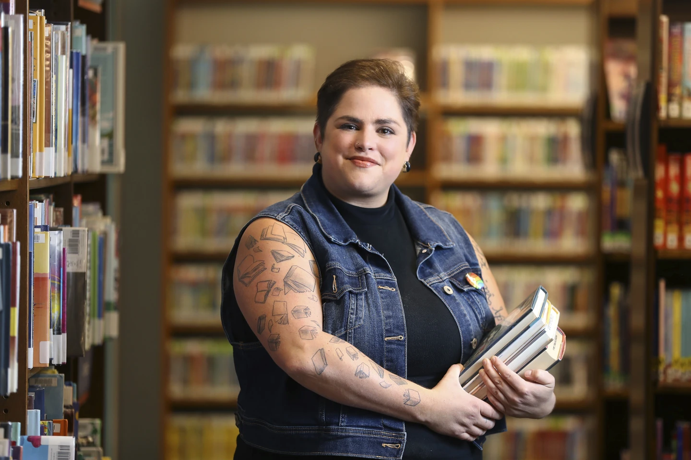

Undervalued Labour
Wider labour market:
  Trans/gender diverse workers:
    make ~30% less than cis workers, regardless of level of education
      Trans women make as low as 60¢ on the dollar
    9% more likely to be unemployed
    42% more likely to work part-time
    2x as likely to hold an entry level position
    60% less likely to hold a managerial position
Within LIS:
  6% of library school students are trans/gender diverse
  Only ~0.3-3% of library workers are trans/gender diverse
  Queer and trans/gender diverse library workers are:
    over-represented in lower level roles and under-represented in managerial roles
    more likely to be precariously employed
    receive lower pay than their cis/het counterparts
Maiorana, J. (2024). Chaz Carey poses for a photo at a library in Worthington, Ohio, Tuesday, June 11, 2024. https://apnews.com/article/lgbtq-librarians-library-workers-gender-queer-book-bans-4ac552901f7ab0eca3a9dcf070b24350
Notes:
Trans/gender diverse workers labour is undervalued both socially and in pure economic terms. Within the wider labour market we make 30% less than our colleagues regardless of our level of education. Trans women make as low as 60cents on the dollar. We are 9% more likely to be unemployed, 42% more likely to work part time, twice as likely to hold an entry level positions, and 60% less likely to hold a managerial position.
Within LIS specifically, 6% of library school graduates are trans/gender diverse, yet we make up only around 0.3-3% of the workforce. Queer and trans/gender diverse library workers are over-represtened in lower level roles, under-represented in managerial roles, more likely to be precariously employed, and receive lower pay.

Slide 8

Academic Libraries
Trans/gender diverse library workers in academic libraries face particularly dire material conditions:
  Only ~0.3% of ARL library workers are trans/gender diverse
  No non-binary people were reported at the level of Dean/Director/University Librarian, Associate/Assistant Dean/Director/University Librarian, or Branch Library Head
2023 ARL Survey | Non-Binary | Women | Men
Average salary | $76,103 USD | $89,624 USD | $94,488 USD
Canadian Average | Unknown | $119,088 USD | $118,435 USD
Highest Salary | $120,000-129,000 USD | $300,000 USD | $300,000 USD
University of Victoria (2024). Dragushan plans to pursue graduate study in library and archival studies. https://news.uvic.ca/2024/finding-trans-community-in-the-archive/
Notes:
The situation in academic libraries specifically is particularly dire. Only 0.3% of ARL library workers are trans/gender diverse. According to the latest ARL survey, no non-binary people were reported at higher level managerial or leadership roles. We are also paid less. The average salary for a non-binary library worker is more than ten thousand dollars less than those of men and women. The proportion of us in Canadian libraries is so low that we don't know how much we make. The highest salary for a non-binary library workers is less than half that of a cis man or woman.

Slide 9
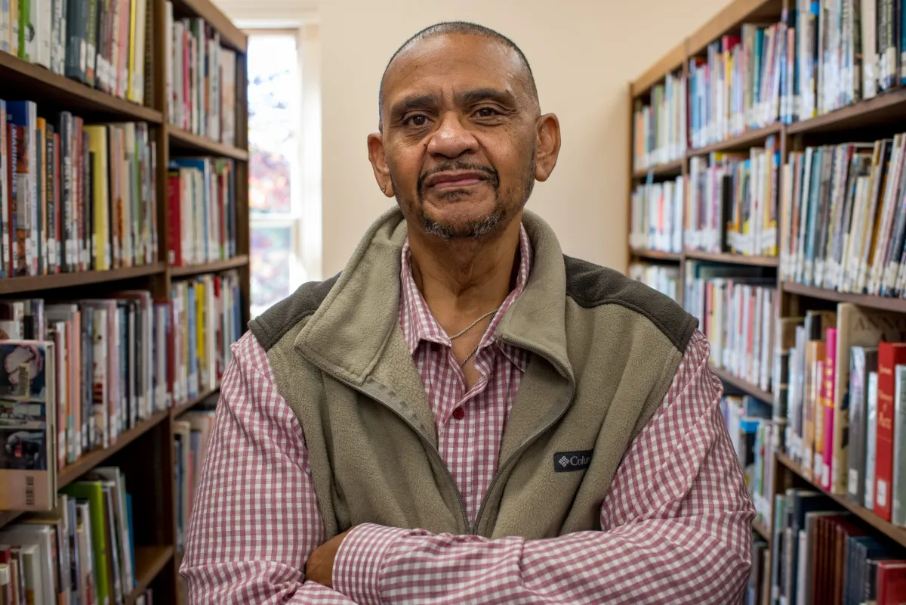
Why is This Not Discussed?
  “Population is too small”
    No acknowledgement of any intentional efforts to recruit trans/gender diverse respondents
    No acknowledgement that trans/gender diverse workers are under represented even based on their demographic makeup within the population
      Makeup of ARL non-binary workers is 2/3rds smaller than the Canadian population
      Makeup of trans/gender diverse library school students is 2x the population
  Flawed methodology
    Only non-binary workers are counted
    No accounting for the differing salaries for binary trans people or other types of gender diverse people
  You don’t care
    Survey analysis acknowledges pay gaps between men and women only
    No acknowledgement of disaprity between cis and trans/gender diverse workers in general
Kori Price/Charlottesville Tomorrow (2022). Charley Burton lost his job at the Federal Executive Institute in Charlottesville after President Donald Trump issued an executive order to shut the campus down. https://news.uvic.ca/2024/finding-trans-community-in-the-archive/
Notes:
Why is this not discussed? A lot of surveys will say that our population is too small. I have never see any of these surveys mention any efforts to intentionally recruit or reach out to trans/gender diverse respondents. I have also never seen any acknowlegement that we are statistically underrepresented. The population of trans/gender diverse people in Canada was 3% according to the latest census, and this is considered to be a conservative estimate. 0.3% is a servere underrepresentation based on both our demographic makeup within the wider population and our makeup with library school ranks.
Many of these surveys also have flawed methodologies. Often only non-binary workers are counted separately and there is no accounting for differing salaries for binary trans people or other types of gender diverse people. I often see these kinds of gender categories created by cis people that have no consulted with trans/gender diverse people at all about the ways we describe or categorize ourselves.
This is also not discussed because, to be frank, you don't care. I have never seen analysis in any of these surveys that acknowledge the pay gap between cis and trans people, depsite the fact that it discusses other gender based pay imbalances.

Slide 10

Wagner, 2023; Bieraugel, 2023; Watson et al., 2023; Jones et al., 2019; Anonymous, 2023a; Anonymous, 2023b; Cantina, 2023; Gherl, 2023; Viola, 2023; Heyer, 2023; Baker, 2023; Walters, 2023; Goodrich, 2023; Hogan-Stacey, 2023; Klein, 2023; Correia, 2023; Jones, 2023; Cal the Saprotroph, 2023; Plante, 2023; Hunter, 2023; Burnham, 2023
Common Experiences
  Having complaints filed against them
  Microaggressions of any and all varieties
  Having pronouns banned in email signatures by their institution
  Losing access to promotions and professional opportunities
  Being told they could not work with youth because of their identity
  Being told they could not ask — or being reprimanded when they did ask — coworkers to use their chosen name or pronouns
  Having slurs hurled at them or jokes made about them by patrons or coworkers
  Receiving targeted harassment and/or bullying from coworkers
  Having requests for institutional supports denied
  Being outed or deadnamed by their email or other systems run by institutional IT departments
  Being outed to their coworkers, supervisor, and/or human resources
  Having queer or trans-positive programs and displays challenged, denied, or sabotaged by their institution
  Being written up for minor infractions after their gender was revealed
  Losing or being forced out of their job due to their gender
Hodson, A. (2024). Rezyl Grace - holding book, chatting. https://apnews.com/article/lgbtq-librarians-library-workers-gender-queer-book-bans-4ac552901f7ab0eca3a9dcf070b24350
Notes:
Through my analysis of testimony from trans/gender diverse library workers in a variety of roles and institutions I noticed the following trends and common experiences.
Trans/gender diverse library workers report of having complaints filed against them, such as for using the washroom; enduring
microaggressions of any and all varieties, such as being asked “why pronouns matter”, being repeatedly and consistently misgendered or deadnamed both publicly and privately, being told by a colleague that they would not be seen as female until they had no “trace of facial hair”, and being asked invasive questions about their bodies or health choices. They report having requests for trans competency training or other institutional supports denied by administration; having pronouns be banned in email signatures; being told that they could not work with youth; losing access to promotions and professional opportunities; being told that they could not ask, or being reprimanded when they did ask, coworkers to use their name and pronouns. They have had slurs hurled at them or jokes made about them by their patrons and cowkers; received targeted harassment and bullying from coworkers; been outed or deadnamed by their email or other systems; been outed to their coworkers, supervisors, or HR departments. They have had trans-positive programs and displays challenged, denied, or sabotaged by their institution. They have been written up for minor infractions after their gender was reveal, and they have lost or been forced out of their jobs due to their gender.

Slide 11
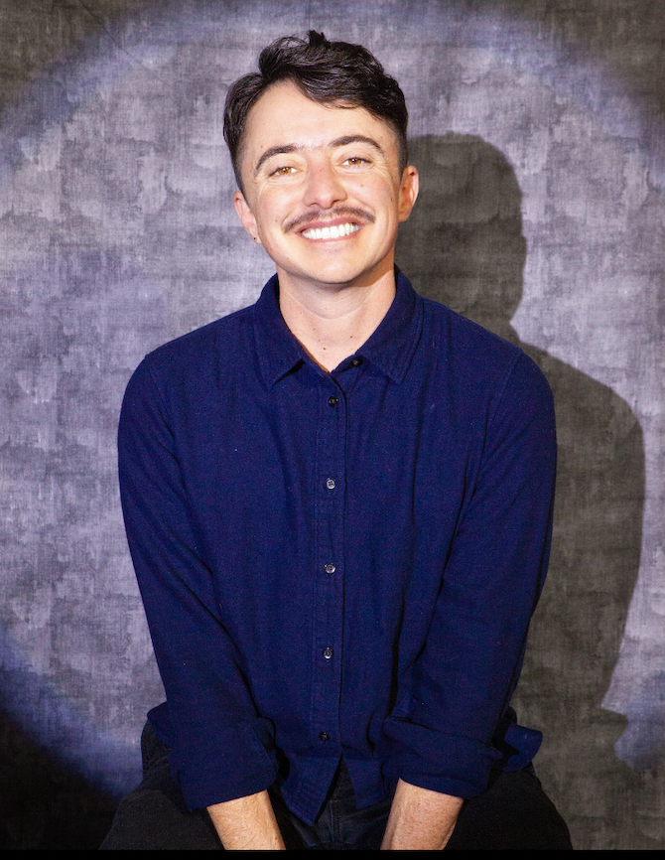
Administrative Violence
  Are libraries inclusive?
    assumptions that trans/gender diverse people don’t work in libraries or are part of their patron base
    workers feel that their administration see them as “politically toxic”
    workers feel that their workplaces are actively transphobic
    platforming of transphobia
    Intersectional oppression - difficulty discerning focus of harassement
    What are administrators and colleagues saying when they think someone is not in the room?
    “the purported dedication of the [ALA] to safety and equity feels the same: it looks good on paper, but the lack of systemic change continues to enable harmful interactions during which those experiencing harm must pander to those enacting it” (Simone, 2023, p. 509)
Dean Spade - trans legal scholar
[Dean Spade]. (n.d.). Dean Spade. https://www.deanspade.net/about/
Notes:
Workers write of having their institutions assuming that trans/gender diverse people do not work there or are not part of their patron base. They describe their administrations viewing them as "politically toxic"; that they feel that their co-workers are actively transphobic; that their libraries platform transphobia through their collections and programming. Those that are intersectionally oppressed describe having difficulty discerning when they are being harassed for being trans/gender diverse versus their other marginalized identities.
Much of the hand waving about inclusivity is milquetoast at best, and empty words at worst. Simone writes "the the purported dedication of the [ALA] to safety and equity feels the same: it looks good on paper, but the lack of systemic change continues to enable harmful interactions during which those experiencing harm must pander to those enacting it".

Slide 12
Administrative Violence
  Coined by Dean Spade (2015)
    refers to how “the administration of gender norms impacts trans people’s lives and how administrative systems in general are sites of production and implementation of racism, xenophobia, sexism, transphobia, homophobia, and ableism under the guise of neutrality” (p. 73)
  Many trans/gender diverse library workers feel distrustful of their administration and colleagues both within their organizations and the field at large
  Performative “allyship”
    Pronouns in email signatures “a slap in the face” when no tangible steps have been taken towards creating a culture or policies and procedures that take trans/gender diverse patrons and workers into account (Gherl, p. 124; Cal the Saprotroph; Held, 2023; Klein)
    “I didn’t need diversity and inclusion statements or Transgender authors speaking at conferences when I couldn’t even safely use the bathroom” (Klein, p. 534)
Dean Spade - trans legal scholar
[Dean Spade]. (n.d.). Dean Spade. https://www.deanspade.net/about/
Notes:
The term administrative violence was coined by legal scholar Dean Spade. It refers to how "the administration of gender norms impacts trans people's lives and how administrative systems in general are sites of production and implementation of racism, xenophobia, sexism, transphobia, homophobia, and ableism under the guise of neutrality."
Trans/gender diverse workers are regularly harmed by administrative violence and it has made them feel distrustful of their adminsitration and colleagues both within their organizations and the field at large. They express frustration at the performative "allyship" of their administrations and colleagues. One worker wrote of seeing pronouns in email signatures as a "slap in the face" when no tangible steps have been taken towards creating a culture, policies, or procedures that take trans/gender diverse patrons and workers into account. Klein writes "I didn't need diversity and inclusion statements or transgender authors speaking at conferences when I couldn't even safely use the bathroom"

Slide 13
Administrative Violence
  Gender segregated facilities and systems are more than just an inconvenience
    “It can be difficult to imagine future possibilities when so many library workers cannot even go to the restroom or fill out human resources paperwork without being forced to misgender ourselves” (Adolpho & Krueger, 2024)
  “‘‘we shouldn’t have to change how we do things, those rare people for whom our ways don’t work can just individually approach us and tell us how to accommodate them’” (Spade, 2010, p. 3)
  Does it really matter?
    being forced to “prove” gender to use bathroom facilities
    systems that deadname and misgender patrons and workers
    “Seeing coworkers routinely assume the gender of patrons can suggest to that employee that this library is not a place where it would be wise to come out.” (Keralis, 2023, p. 286).
Dean Spade - trans legal scholar
[Dean Spade]. (n.d.). Dean Spade. https://www.deanspade.net/about/
Notes:
Administrative systems and policies that negatively impact trans/gender diverse people are often framed as a simple inconvenience. Spade illustrates the attutiude of administrators when they say "we shouldn't have to change how we do things, those rare people for whom our ways don't work can just individually approach us and tell us how to accommodate them". This attitude creates an environment where trans/gender diverse workers have to routinely endure persistent humiliation and discomfort at work. The only way around this is to out themselves to their administration, which can have serious consequences for the worker's career. As a result, change at the administrative level is always intiatied as a reaction to the trans/gender diverse worker.
This type of administrative violence plays itself out in multiple ways. Wagner describes having a formal inquest conducted by their workplace related to their bathroom use that they describe as “professionally and emotionally damaging” and “the greatest trial of my career” (p. 389). Library systems routinely collect gendered data through ILSs, employment applications, and human resource forms. This can result in patrons and workers alike to be misgendered and deadnamed through multiple interations with the library. Even in systems that allow for preferred names to be used, workers may not ask every patron if they have a preferred name, requiring trans/gender diverse patrons to out themselves in order to avoid being deadnamed while applying for a library card. Keralis (2023) posits:
:Seeing coworkers routinely assume the gender of patrons can suggest to that employee that this library is not a place where it would be wise to come out. By enforcing the library as a gendered space, library employees tacitly exclude both patrons and coworkers from fully participating in the library community (p. 286)."

Slide 14
Administrative Violence
  Problems ignored
  Real world impacts
    my experience
      with administrative processes
      with systems
    is capturing gender data necessary?
  Exceptions and carveouts made
    only after significant intervention or advocacy from trans/gender diverse workers
  Some policies or administrative barriers are created that only apply to trans/gender diverse people
    my experience
Dean Spade - trans legal scholar
[Dean Spade]. (n.d.). Dean Spade. https://www.deanspade.net/about/
Notes:
I have experienced the adverse impacts that these types of administrative apparatuses can inflict. As a graduate student I was nearly ejected from my program by the university’s administration due to my mismatched name and identity documents, which was only rectified after my program director stepped in. This occurred despite the fact that I had filled out paperwork, signed by a lawyer, that the school had implemented specifically for trans students that did not have updated identity documents. More recently, I discovered that I was unable to access my pension information through an online portal because the backend of the system was unable to retrieve records with an “X” gender marker. Why gender markers were even included in the backend of a pension portal is beyond me.
At times, policies or administrative barriers are created that only apply to trans/gender diverse people, even when the situation at hand is identical. For instance, while changing my legal sex designation at almost every institution I had to fill out — and often notarize at my own expense — a plethora of paperwork. However, when changing my sex marker at one institution the person serving me mistook me as cis, assumed my sex marker had initially been misrecorded, and changed it within a few minutes without requiring any additional paperwork. The stark difference in treatment I received in a situation where I passed as cisgender, and the ease with which the institution rectified the error, was shocking to me.
These incidents are indicative of the adverse impact of; a) collecting and utilizing unnecessary gendered data and, b) creating specific carve outs for trans/gender diverse people. Approaching transness as a difference that needs to be accommodated through a series of additional administrative processes, rather than simply addressing or removing the barriers or oppressive structures that trans/gender diverse people face, reifies the ways that transphobia is enacted by administrative processes and the undue burden and harm this causes to trans/gender diverse people. Rather than seeking further reform, institutions need to rework their policies, procedures, and systems from the ground up to remove barriers whole cloth.

Slide 15


Immaterial Labour
  Activism within the academy “[remains] productive since this additional labour functions to ‘enhance the social, political and media visibility’ of the university” (p. 10-11)
  “Activism” by library workers is only valued as long as it provides no real threat to the administration
    making cis colleagues or administrators uncomfortable
    pointing out differences
    failing to privilege the emotions of cis colleagues or administrators
  Delicate balance between providing immaterial and emotional labour and ensuring that they effectively assimilate
  Cannot initiate any change or opposition that unsettles cisnormativity
Horn Book. (2019). Kyle Lukoff. Horn Book. https://www.hbook.com/story/five-questions-for-kyle-lukoff-july-2019
Notes:
Activism by library workers, both within the library and through scholarship, is only valued as long as it provides no real threat to their administrations. Within academia, as Almeida argues, activism on behalf of the worker “[remains] productive since this additional labour functions to ‘enhance the social, political and media visibility’ of the university”. Any substantive questioning of, or struggle against, the administrative apparatus or power structures in place creates an inherent risk for the worker, despite the institution’s same demand for emotional labour on behalf of the worker to remain and/or appear to be progressive or inclusive. Resultantly, trans/gender diverse library workers are forced to walk a delicate balance of providing immaterial and emotional labour in support of the institution while still ensuring that they not unsettle the status quo.

Slide 16
Emotional Labour
  Visible
    Requesting policy changes
    Providing additional support to trans/gender diverse patrons or community members
    Asking for training
  Invisible
    Fielding inappropriate questions or comments
    Emotionally supporting colleagues and managers
    Emotionally regulating after having requests denied or enduring harassment
    Emotionally support patrons and community members
    Staying closeted or not speaking out for fear of discrimination, harrassment, censure, missed opportunities or job loss
Trans/gender diverse library workers are forced to perform emotional labour whether it is visible or invisible
Horn Book. (2019). Kyle Lukoff. Horn Book. https://www.hbook.com/story/five-questions-for-kyle-lukoff-july-2019
Notes:
Regardless of whether the trans/gender diverse worker attempts to actively make change within their library, they are still required to perform emotional labour. Visible emotional labour can look like requesting policy chages, provicing additional support to trans/gender diverse patrons or community members, or asking for training. Invisible emotional labour can include fielding inappropriate questions or comments from coworkers and administrators, emotionally supporting colleagues and managers who are uncomfortable around trans/gender diverse people or priviliging their emotions after being misgendered or deadnamed. It can also look like having to emotionally regulate themselves after having requests denied or facing harassment, as well as staying closeted or silent out of fear of discrimination, harrassment, censure, missed opportunities, or job loss.

Slide 17
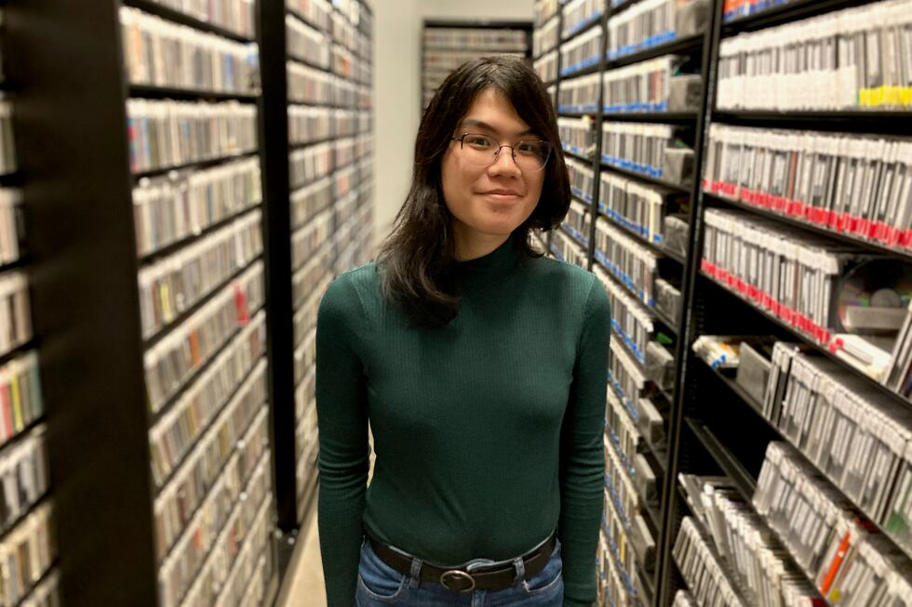
Social Reproduction
  Trans/gender diverse workers are required to assimilate to gain employment or remain employed
    “under the tyranny of employers, all workers face day-to-day gendered expectations … the opportunity for trans people to transition or find employment in the first place, are constrained as one feature of this broader regime of class rule” (O’Brien, 2021, p. 58)
  What does professionalism look like for trans/gender diverse library workers?
    Unclear expectations
    Need to remain legible
    Need to stay closeted or “cross dress”
  Acceptance under the terms of the ruling class:
    Assimilation
    No attempts to challenge the status quo
    Operate under a mode that is financially, politically, and/or reputationally advantageous
  Failed initiatives and band-aid “solutions” have done nothing
    pointed to as attempts at change
Valdes, M. (2023). Maia Xiao poses for a portrait in the library of radio station KEXP where she volunteers in Seattle, Feb. 17, 2023. El Pais. https://english.elpais.com/society/2023-02-25/bills-would-let-transgender-people-seal-name-change-requests.html
Notes:
The libary's social reproduction requires trans/gender diverse workers to assimilate to both gain and retain employment. This exists, as O'Brian posits, as a wider feature of class rule. One way that coercive assimilation is enforced is through so-called "professionalism". Professionalism codifies certain behaviours, practices, and aesthetics that are inherently gendered and class-based, and which require the trans/gender diverse worker to conform to white, western, patriarchal, heteronormative, and cisnormative female or male-coded aesthetics. The expectations for professionalism are both unclear and fraught. Bieraugel states “there is no real guidance for non-binary trans people on how to dress, how to act, how to ‘be professional’” (p. 299). Krahmer describes needing to remain closeted and “cross dress” in order to gain and retain employment. Gherl, notes how they had to question “how much of [their] gender performance was a result of fulfilling social expectations and how much was for [them].”
Under neoliberalism gender and sexual diversity are only accepted on the terms of the ruling class and only when the subject; 1) assimilates, 2) does nothing to challenge the status quo, and 3) operates under a mode that is financially, politically, and/or reputationally advantageous. As Barnard (1996) contends, neoliberalism “legitimates its rule precisely by insisting that it permits oppositional voices and identities to exist” (p. 79). As a field we know that there is a significant disparity between the predominantly white, cisgender, heterosexual, able-bodied, neurotypical librarians and the rest of us. The library workforce is currently estimated to be 83-86% white (Kendrick, 2023). Between 2009 and 2017 there was nearly no movement on recruiting and retaining librarians of colour, with an increase of less than 1% (Hulbert & Kendrick, 2023). Librarians with disabilities make up an estimated 3.7-5.9% of the workforce and, as stated previously, gender diverse workers are estimated to make up 0.3-3% (Oud, 2019). It is clear that the performative, neoliberal attempts to address structural inequities in the field are failing; diversity residences, DEI initiatives or committees, milquetoast training, book displays, etc. are all largely ineffective (Morales et al., 2014). Worse, these initiatives are often pointed to as attempts by those in power that they are working to rectify these inequities, without sufficient supporting evidence.

Slide 18
Social Reproduction
  Structural barriers
    lack of financial resources
    student loan debt
    lack of familial or social support
    intergenerational trauma
    unconcious bias
    prejudice
    discrimination
    unstable housing
    access to community and medical care
  Those that manage despite these are held up as indicators that their institutions are meritocratic and diverse
All of the same structural barriers experienced by trans/gender diverse workers in society are replicated and reified by libraries
Valdes, M. (2023). Maia Xiao poses for a portrait in the library of radio station KEXP where she volunteers in Seattle, Feb. 17, 2023. El Pais. https://english.elpais.com/society/2023-02-25/bills-would-let-transgender-people-seal-name-change-requests.html
Notes:
Within librarianship, meritocracy positions itself as a method of levelling the playing field despite the unequal and significant life circumstances that must be in place to be considered a viable candidate for employment or promotion. These include student loan debt, family obligations, lack of financial resources, lack of familial or social support, intergenerational trauma, inability to relocate, unconscious bias, prejudice, discrimination, etc.
Trans/gender diverse workers are required to overcome these significant barriers to succeed within the field and, when they do, are held up as indicators that their institutions are meritocratic and diverse. All of the same structural barriers experienced by trans/gender diverse workers in society are replicated and reified by libraries.

Slide 19
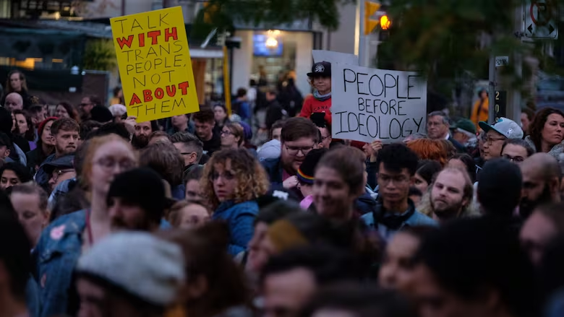

You Can’t DEI Your Way Out of This
  Libraries force workers to make a choice between degradation and increased labour
    no guarantee that attempt at change will be fruitful
    risk that attempts at change can result in adverse consequences
  The neoliberal library prefers to distill the trans/gender diverse experience down to simple identity politics
  Libraries need to critically interrogate their policies, procedures, systems, and culture
We are Under Attack
  It is not possible to decouple material conditions from success or wellbeing in the field
  Rapid increase in hate crimes, discrimination, and attempts to legally eradicate and erase trans/gender diverse people from public life
  Neoliberal “inclusion” is not enough to combat these attacks
Mitsui, E. (2019). Protesters gathered at the Palmerston branch of the Toronto Public Library as Meghan Murphy spoke inside on Tuesday evening. CBC/Radio-Canada. https://www.cbc.ca/news/canada/toronto/megan-murphy-toronto-library-protest-1.5339909
Notes:
The neoliberal library prefers to distill the trans/gender diverse experience down to simple identity politics. Library administrations have treated us like exceptions, required uncompensated and unrecognized emotional labour, implicitly and explicitly demanded assimilation, undervalued our labour economically and systematically, paid lip service to our marginalization or outright ignored it, and enacted and weaponized administrative violence against us. The library does not engage with the ways that marginalized workers' identities directly impact their material conditions, and thus their ability to participate in the field. They do not acknowledge how their social reproduction demands the totality of the worker rather than allowing for the trans/gender diverse worker to express or produce self-realization or autonomy. The culture and administration of libraries, the slap dash and ad hoc nature of these “reforms”, harm trans/gender diverse library workers. It is imperative that libraries confront how their policies, procedures, and culture result in conditions that not only subjugate trans/gender diverse workers, but workers and patrons at large.
Particularly during a period of rising facism and the scapegoating of trans/gender diverse people as a response to economic disparity and insecurity, the emancipation of trans/gender diverse workers is intrinsically tied to the abolition of class disparity entirely. Trans/gender diverse library workers face increasing attacks by the government, populace, and library administrations. We are currently experiencing a rapid deterioration in rights and an onslaught of hate crimes, discrimination and attempts to legally eradicate us from public life.
This is not theoretical. I have had to take a self defense course after being screamed at on the street and on public transit, I have been denied service by the government and private businesses, my partner and I have had to seriously discuss where we would seek asylum if and when it is no longer safe for us to live here. Neoliberal “inclusion” is not enough to combat these attacks.
I implore all of you, in this room, right now to seriously think about whether you have ever questioned any of this. Whether you have ever looked around and noticed the absence of your trans/gender diverse colleagues, whether you have thought about the signficant barriers the colleague you do have had to overcome to be there, and whether you have considered how the current political climate is impacting us. I have been warned about how speaking out about this may adversely impact my career. I beg you to start looking around and paying attention both at work and in your personal lives.
We need actual support, we need drastic improvement to our material conditions, and we need public acknowledgement that this is happening to us. We are a significant minority and without active and vocal solidarity, we may not survive.

Slide 20
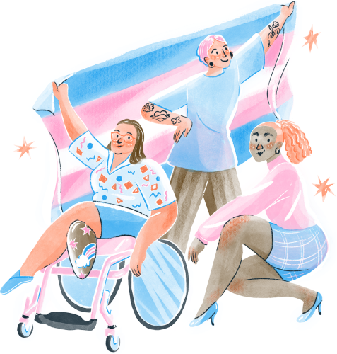
Thank You!

