Slide 1

Supporting an OER Finding Service: Utilizing Past Experiences
Sarah Adams (she/her)
Open Education Librarian University of Calgary
CAPAL Conference 2025
June 2, 2025

Slide 2
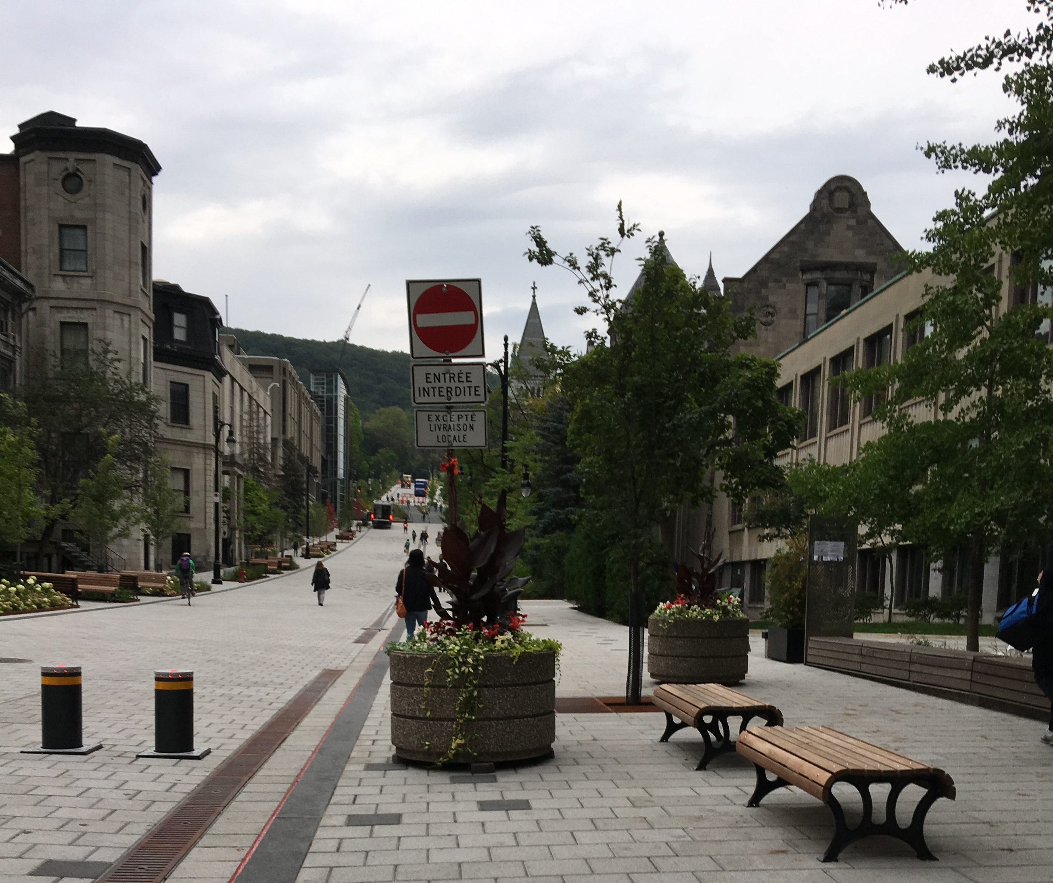
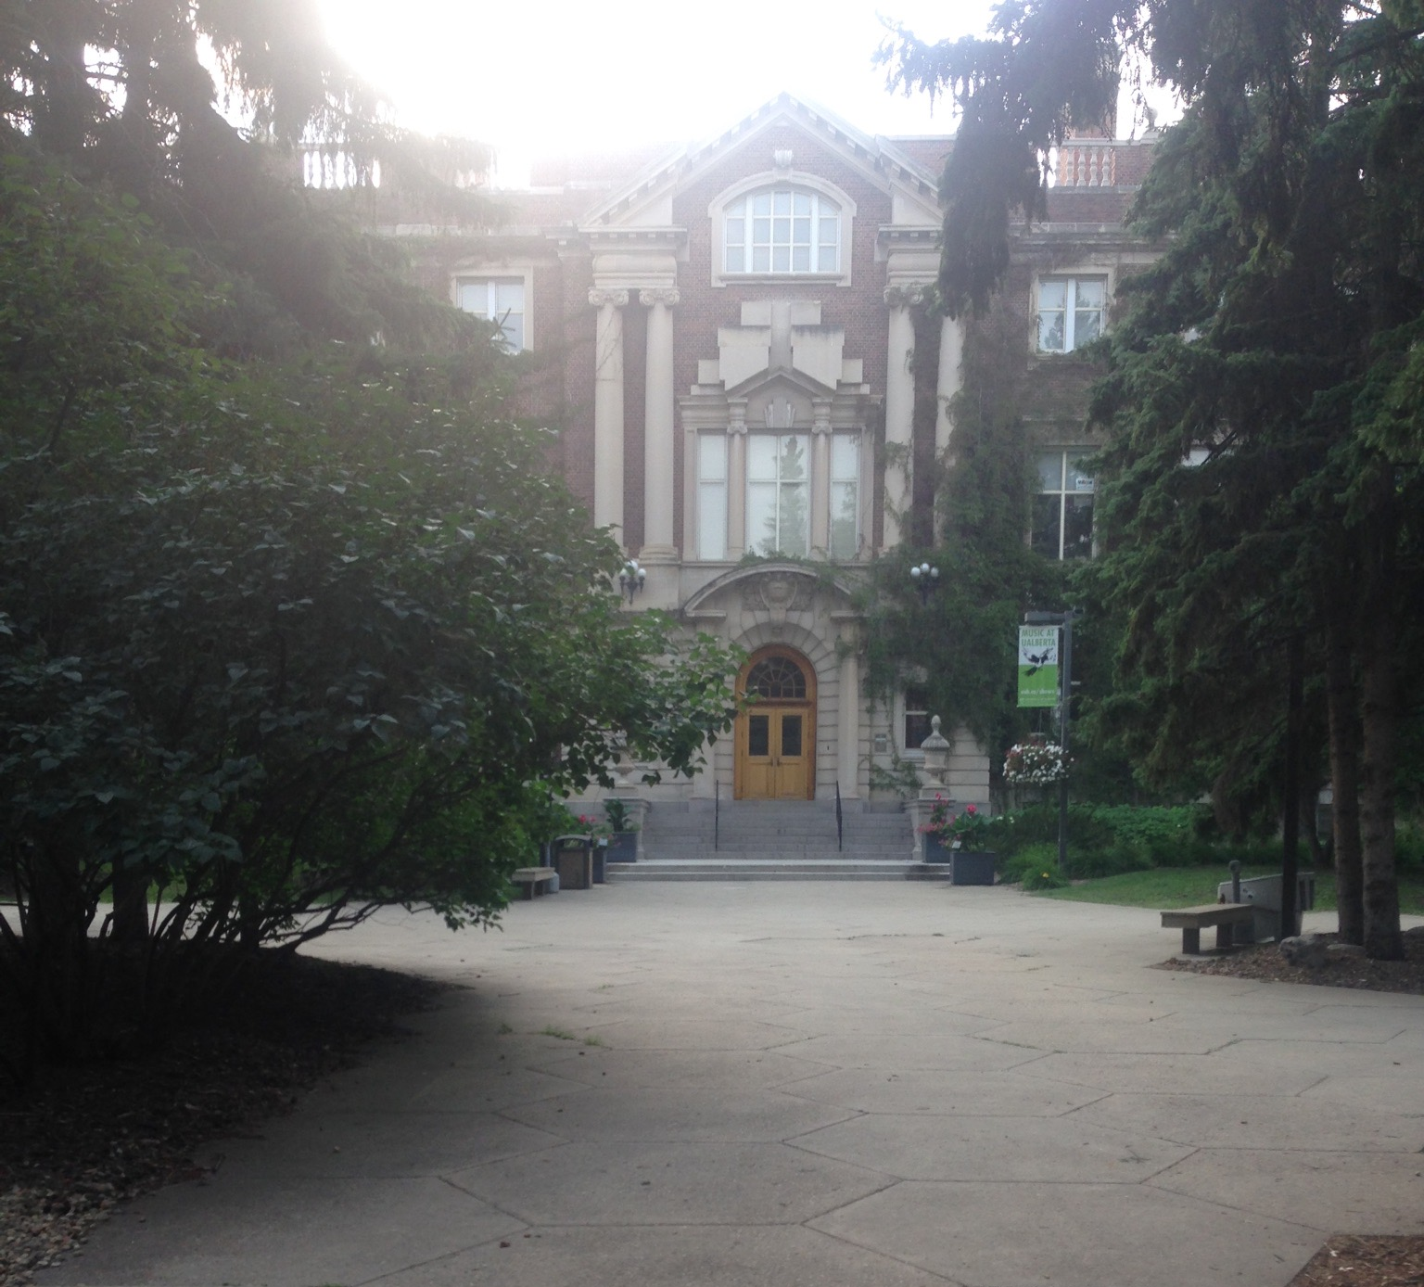
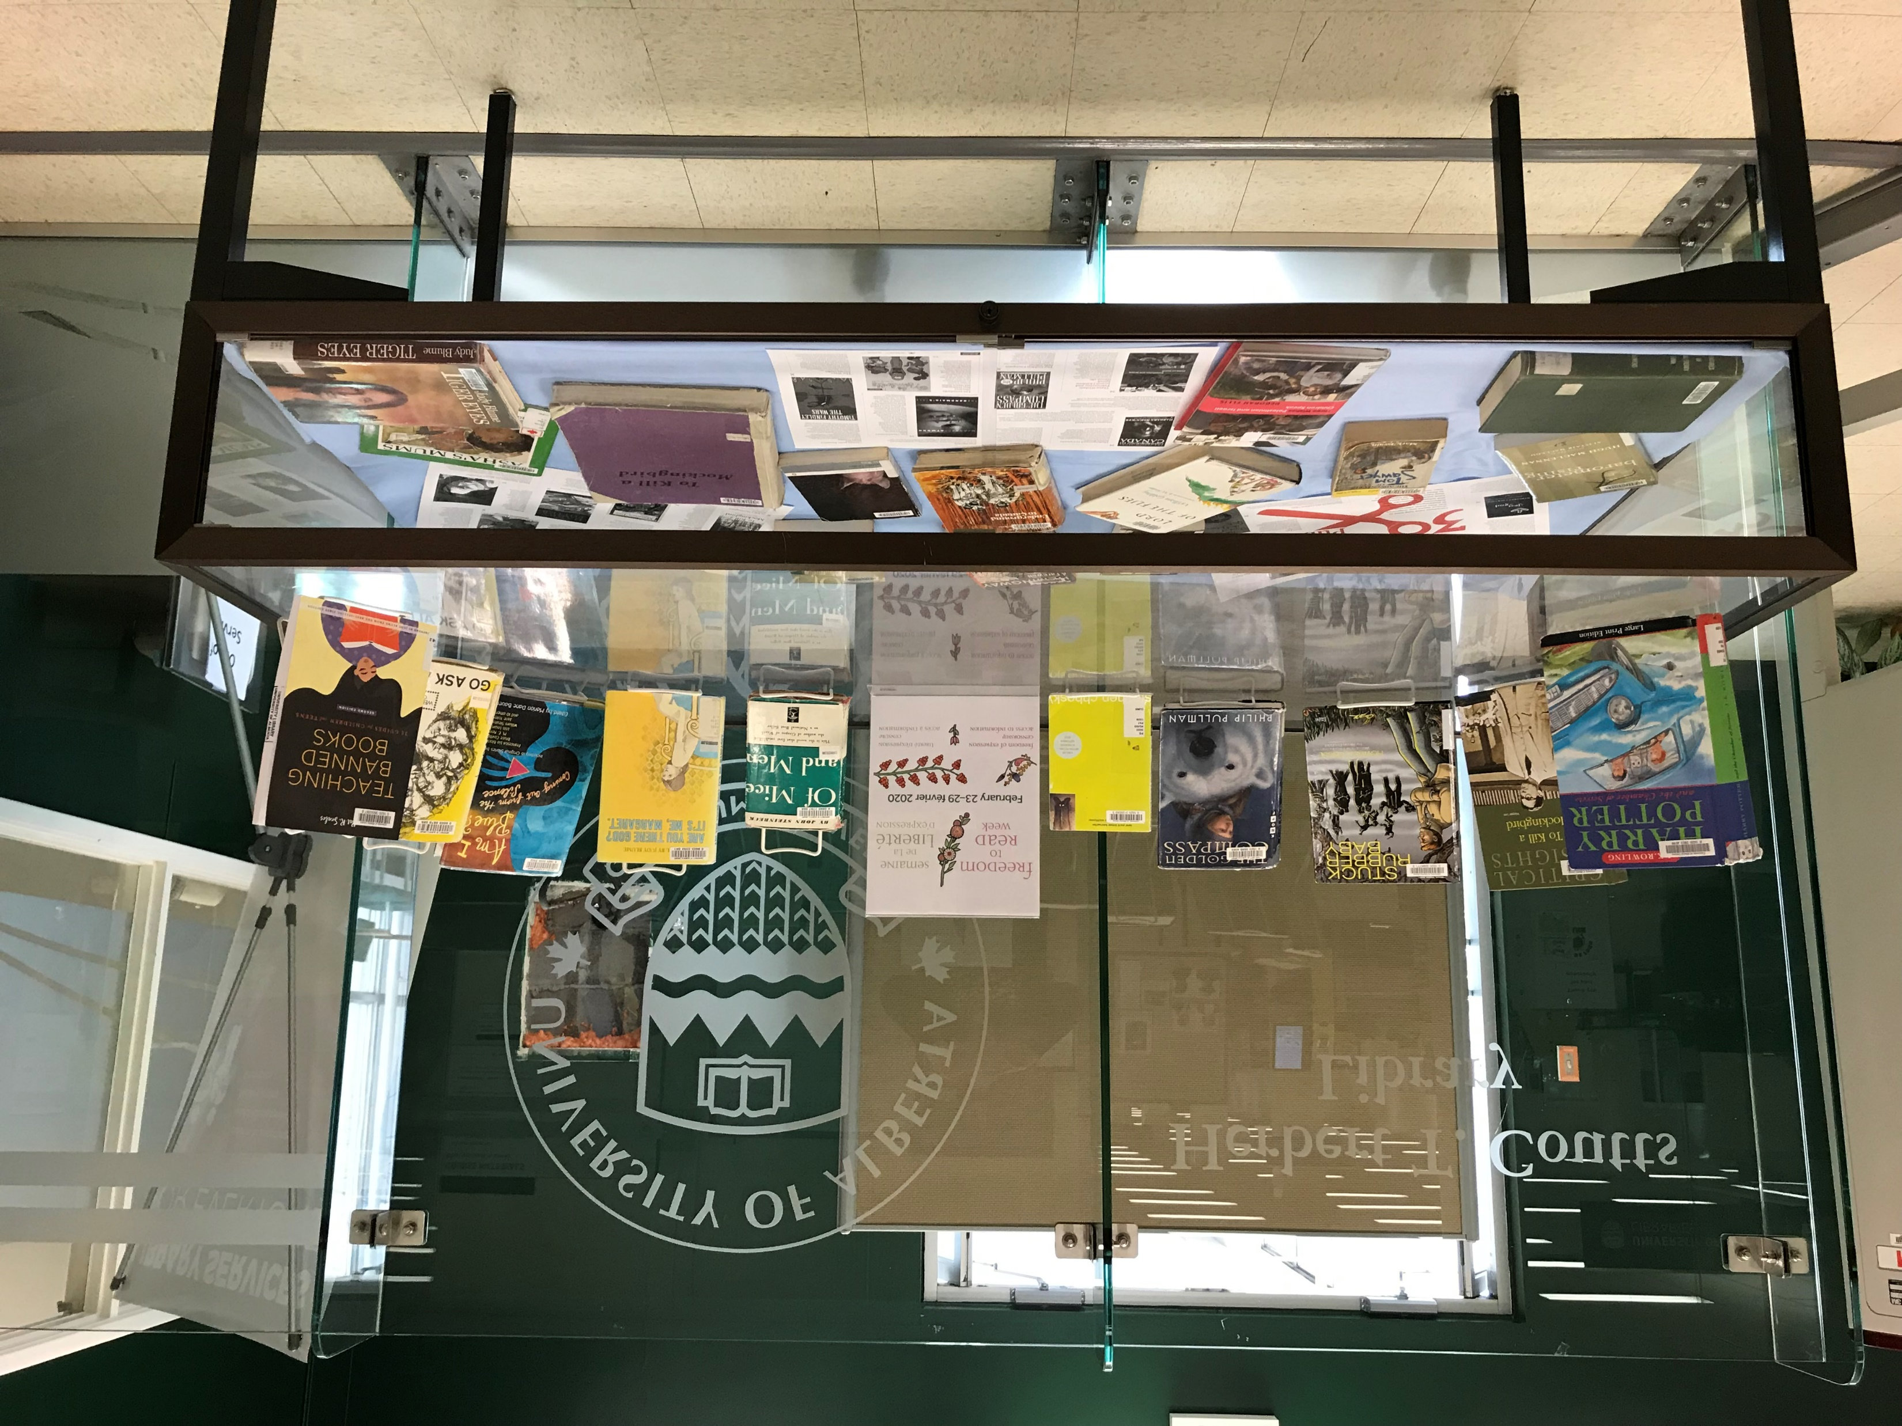
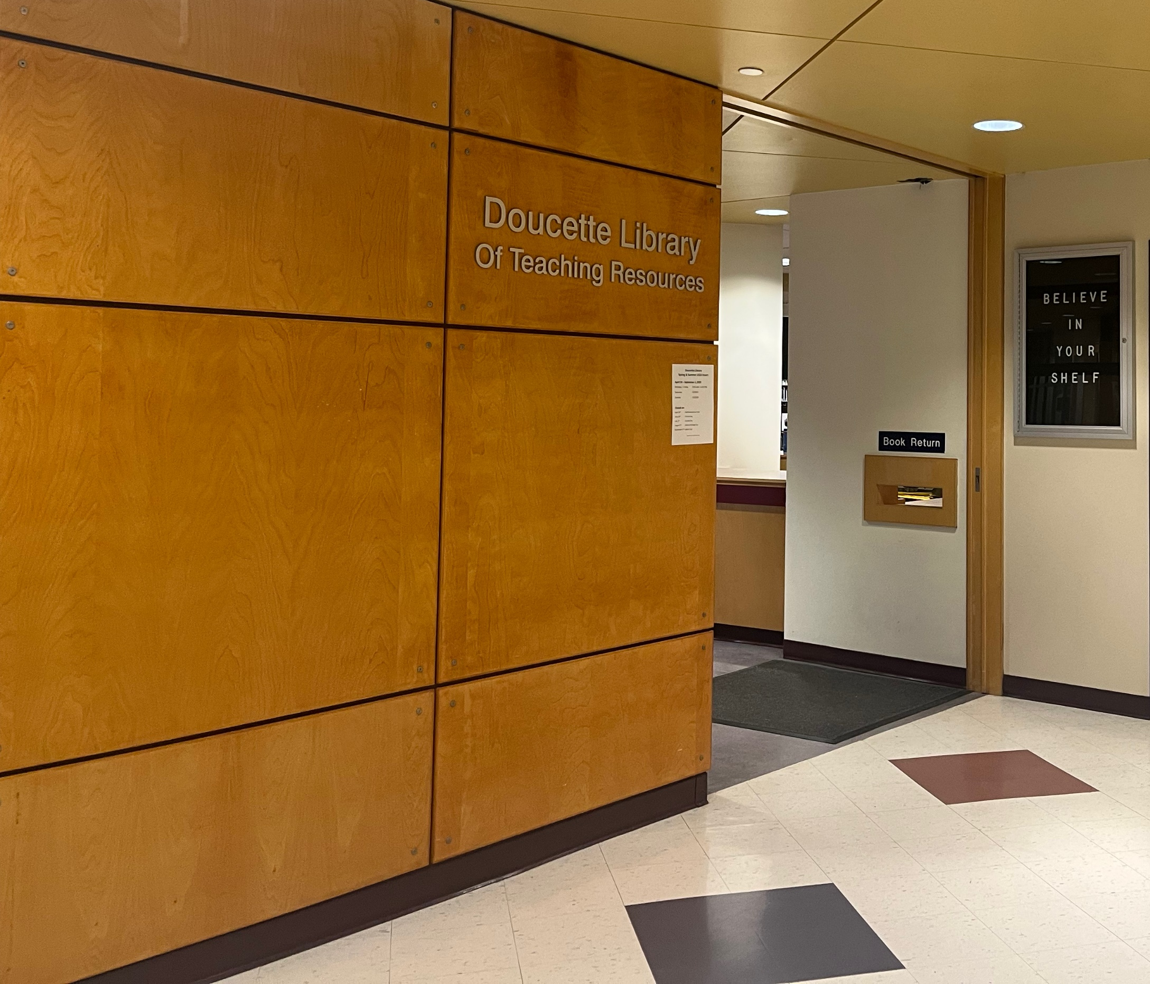
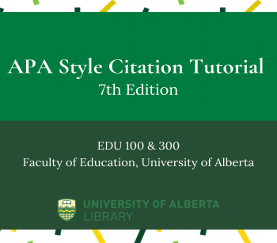

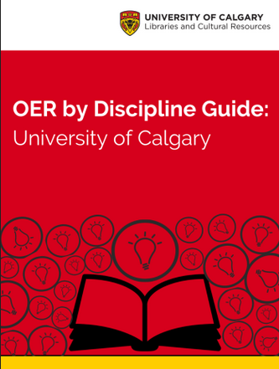

Journey to Supporting OER
University of Alberta
Education
McGill University
Information Studies
University of Alberta
Education Librarian
University of Calgary
Open Education Librarian
Student Teaching
Social Studies
Practicum 1: Gr. 7-9
Practicum 2: Gr. 10
RBSC
McGill Library
Teaching & Learning Services

Slide 3
Open Educational Resources (OER) Defined
Learning, teaching and research materials in any format and medium that reside in the public domain or are under copyright that have been released under an open license, that permit no-cost access, re-use, re-purpose, adaptation and redistribution by others (UNESCO, 2021).

Slide 4

About UCalgary’s OER Finding Service
Goal: reducing barriers for finding OER – time, effort, navigating new repositories
Service is not embedded in liaison librarian roles, dedicated support staff
https://libguides.ucalgary.ca/guides/ocomms

Slide 5
OCoMMS: Additional Use Cases
  UCalgary Teaching and Learning Grant - OER area of focus
    Connections within grant application
    Locate potential OER for adaptation
  Curriculum review and development
    Supports available to find OER
    Focused at the program-level

Slide 6
OCoMMS Staffing Model
Staffing Model
Led by Open Education Librarian
Started summer 2021 and 2022 with student librarian support
Transitioned into embedded responsibility in an assigned Information Specialist position
Strengths:
  Searching for OER is similar to reference services
  Increases sustainability in staffing

Slide 7
OCoMMS: A Collaborative Process
Collaborate with Information Specialist
Librarian will intake the request
Two searches conducted
Librarian will communicate with instructor about report and next steps
Communicate and collaborate with liaison librarians
Depends on request type, course needs, capacity
Opportunity for library, archives, and special collections too!

Slide 8
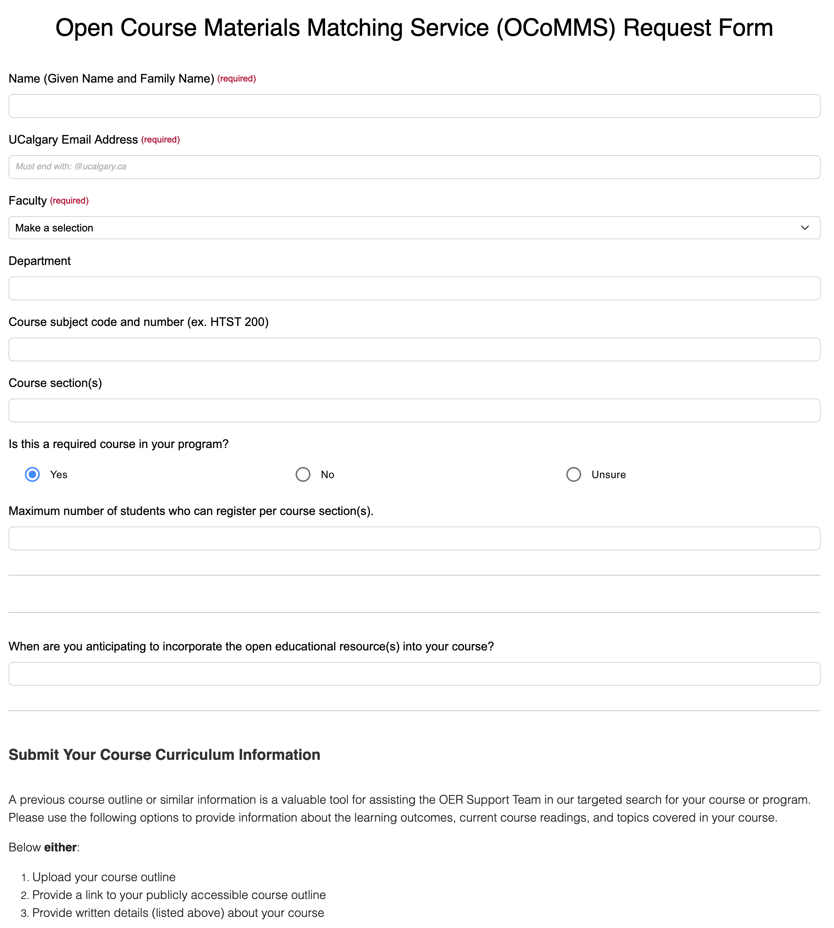
OCoMMS:
Starting a Request
By request instructors submit through:
  Request form
  Email
OER adoption is not required
  Provides increased awareness of available course material options
  Upholds academic freedom
https://libguides.ucalgary.ca/guides/ocomms/requestform

Slide 9
OCoMMS: Search Considerations
Adoption of OER can encourage other open educational practices, such as assessments and curriculum design.
Keep this in mind when looking for OER
One perfect OER may be difficult to find – opportunity to create a new OER by bringing multiple together
Like a digital coursepack!

Slide 10
About Backward Design
A planning framework from Understanding by Design by Wiggins and McTighe
  Centralizes learning outcomes within a course’s curriculum
  Then on how students will meet those learning outcomes – how will they express their understanding
  Followed by designing curriculum and lesson planning with instructional strategies, activities, and materials – how students will engage in their learning
Learning Outcomes
Assessment
Designing Instruction
Evidence of learning and understanding
Supporting student learning and engagement
Goals for student learning
Course materials

Slide 11
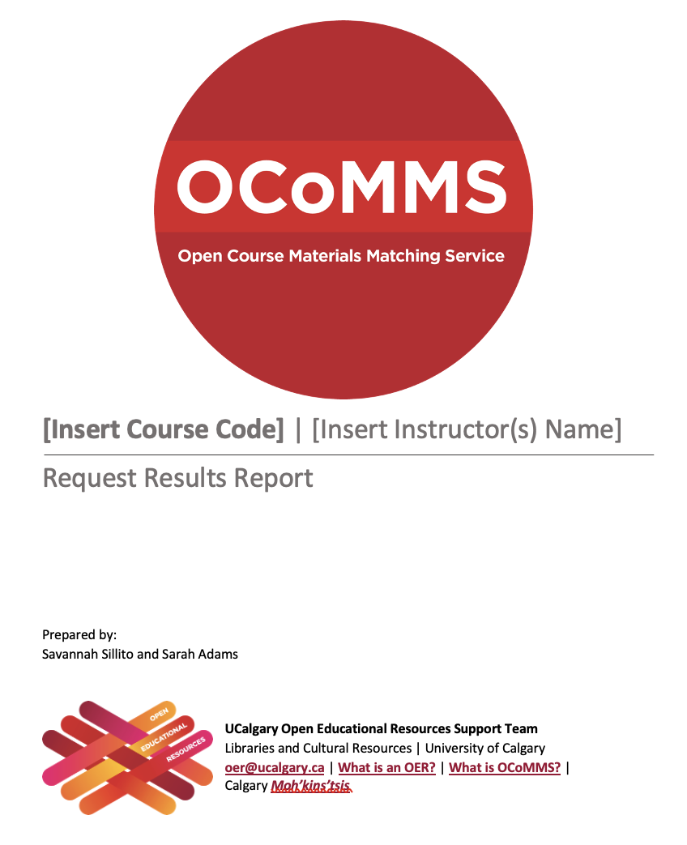

OCoMMS Documentation
Two packages:
  Support team
  Instructor
More user-friendly
Reduced needed information
https://bit.ly/ocommsreports

Slide 12
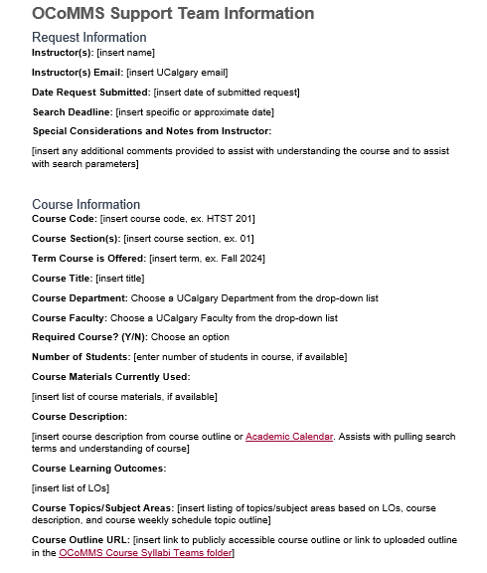
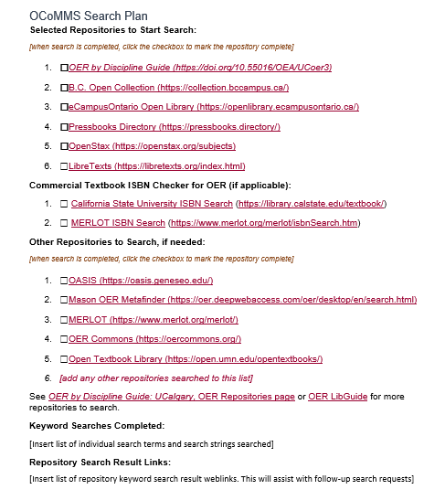
Developing our Search Strategy

Slide 13
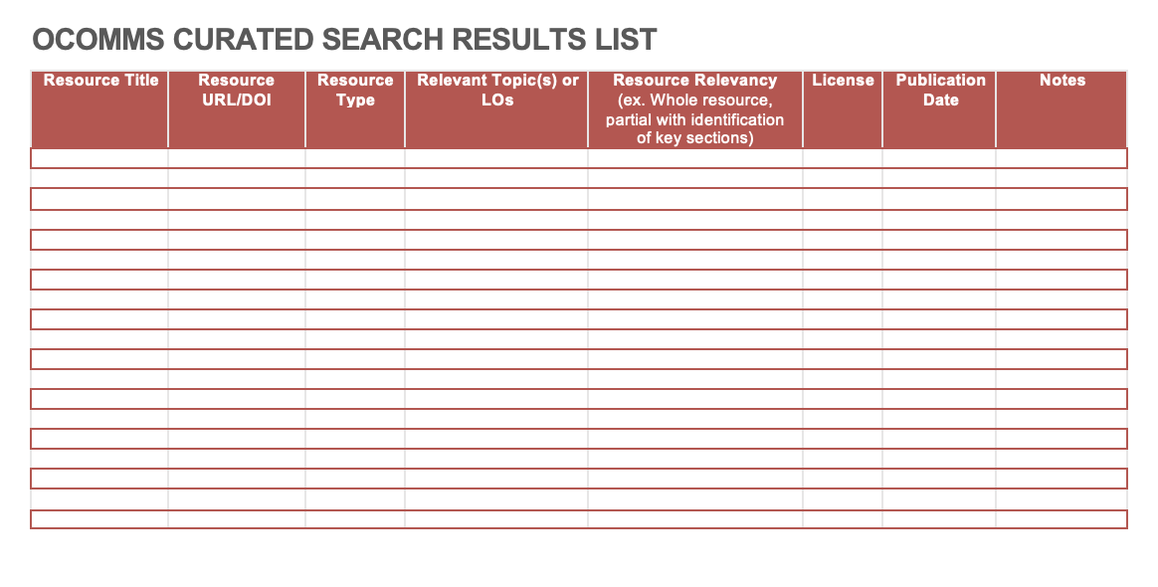
Recording our OER Discoveries

Slide 14
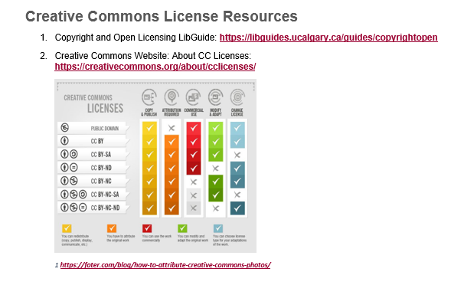
Copyright and Open Licensing
Provide resources in report
  May be new to instructors
  May have experience through Open Access publishing
Helpful experiences:
  MISt archival courses: Archival Principles and Practice
  Archival Assistant role: Casey Wood Collection, collected up until 1960s
Notes:
Common question: what is the “right” CC license?

Slide 15
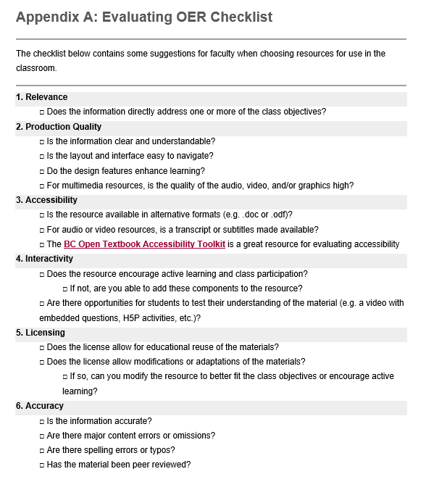
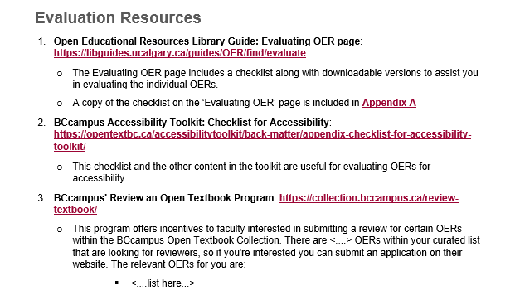
Evaluating OER
Provide a resources and a checklist
Helpful experience:
  Student teaching practicums
Notes:
We conduct a preliminary assessment of the OER as we curate them. Instructors as the subject and course expert are responsible for a more in-depth evaluation to see if any OER discovered fit their needs. This process should be fairly similar to practices for any course materials that are reviewed.

Slide 16
Impact: Tracking and Sharing
If adoption reported, calculate estimated cost savings
Sharing form for more complete data collection
Track overall savings and requests
Helpful experience → MISt database course
Goal: tell stories
Instructor’s experience
Library-based/service impact
https://libguides.ucalgary.ca/guides/OER/impact

Slide 17
Share Your Experiences
What lived experience do you bring when supporting instructors with finding new OER, course materials, or other resources?

Slide 18
Thank you
Contact: sarah.adams1@ucalgary.ca

Slide 19
Slide Attribution
Open Course Materials Matching Service (OCoMMS): Reducing Barriers and Building Sustainability for OER Adoption by Sarah Adams and Savannah Sillito is licensed under a Creative Commons Attribution 4.0 International License.

