Slide 1


Weaving a Librarian’s lived experience into teaching: knowledge transfer through the lens of an immigrant information professional.
Inaam Charaf, Ph.D.
Assistant Professor
Department of Information Studies
University of the Fraser Valley

Slide 2
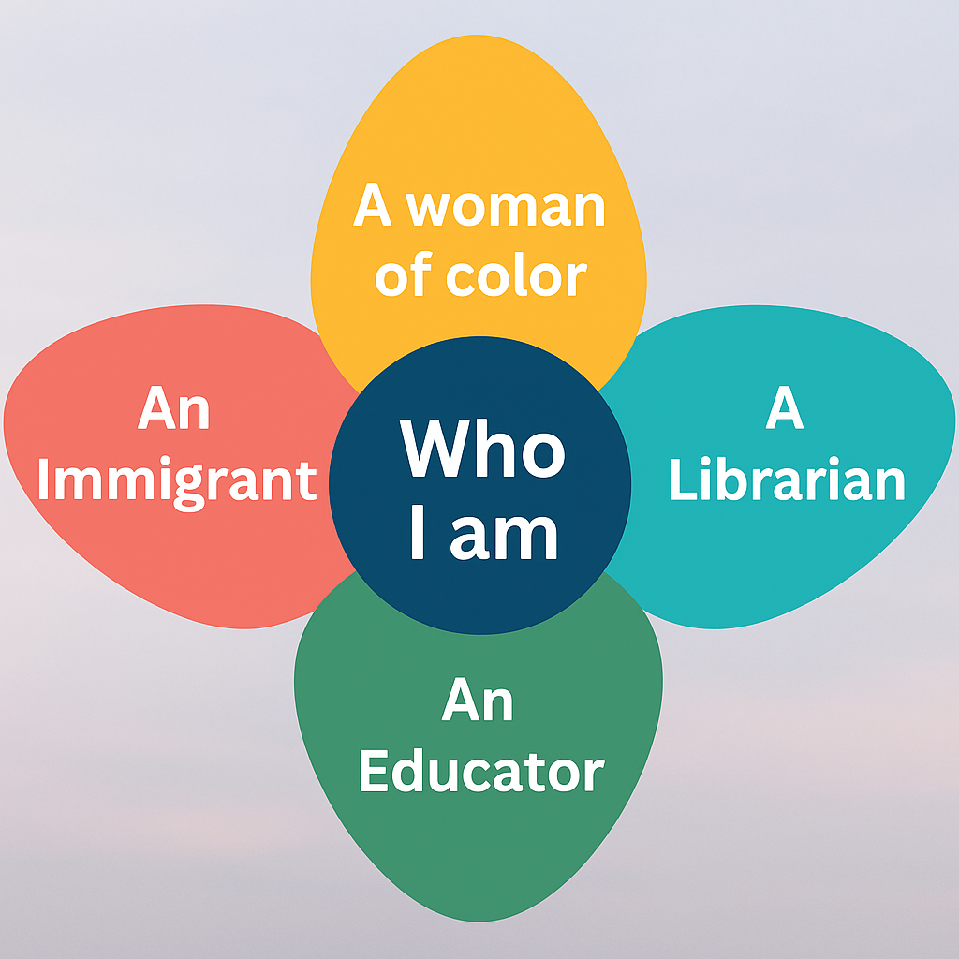


Slide 3

Teaching Through a Critical Race Feminism Lens

Slide 4
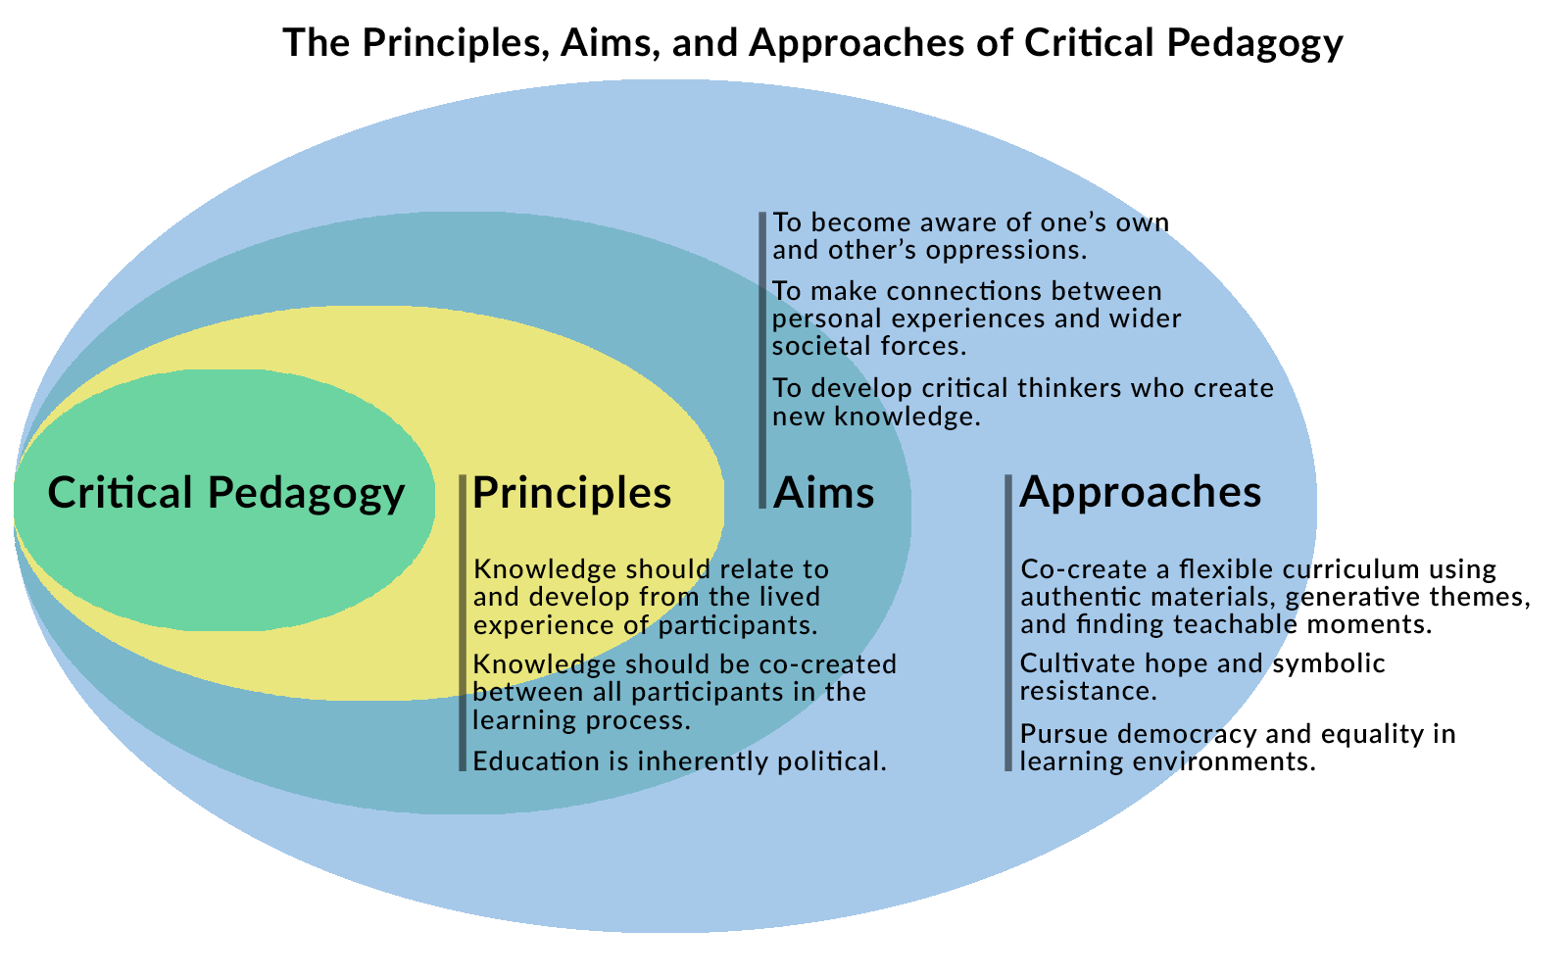
Adapted from Seal & Smith, 2021

Slide 5
Critical Race Feminism Pedagogy
Storytelling and counter stories
Giving students space to share their lived experiences and counter-narratives
Grounded in realities
Examining and engaging with real-life scenario and incidents
Praxis is central to theory
Centering students’ lived experiences to bridge theory and action
Culturally responsive
Adapting teaching to reflect students’ cultural contexts and identities
Mutual vulnerability
Fostering shared openness and reflection across cultural differences
Notes:
This model is developed based on a study published by Theodorea Berry and Matthew Candis in:
Berry, T. R., & Candis, M. R. (2013). Cultural identity and education: A critical race perspective. Educational Foundations, 27(3–4), 43–64.
It illustrates how Critical Race Feminist pedagogy informs my teaching practice, centering student voice, identity, and justice-oriented engagement.

Slide 6
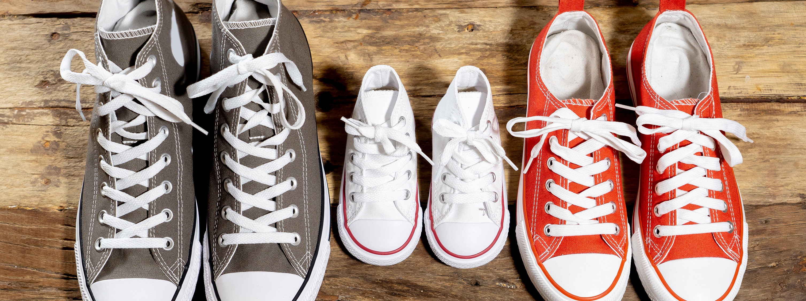
Living, Knowing, Teaching: Embedding Critical Race Feminist (CRF) Principles in the Classroom
For example:
I apply a CRF lens in Introduction to Classification (LIBT 130), to challenge dominant knowledge structures, center marginalized perspectives, and invite students to reflect on the power dynamics embedded in classification systems.

Slide 7
Meet Jaz: A Story of Care, Curiosity, and Classification
Jaz is the newest addition to the library team—a thoughtful, brilliant, and deeply curious library assistant. As a Black trans woman and someone who identifies as neurodiverse (autistic), Jaz brings a perspective to the library shaped by both personal resilience and a deep appreciation for the richness of human experience. She sees libraries not just as places of information, but as spaces where stories live, breathe, and connect us.

Slide 8

Jaz as a core persona: the friend of the classification lab
Jaz is a recurring character in my classification course—more than a fictional figure, she’s a pedagogical companion.
A Black, transgender, and neurodiverse (autistic) library assistant, Jaz brings intersectional depth and lived experience to the learning space.
She learns and grows alongside students, modeling curiosity, vulnerability, and critical thinking.
Jaz appears across multiple scenarios, asking questions, seeking guidance, and sparking thoughtful discussions about classification, identity, and power.
She serves as both a pedagogical tool and an emotional connector, helping students engage more personally and reflectively with the course material.

Slide 9

Why Black, Transgender and Neurodiverse?
Centering lived experience through a CRF lens
Reflecting
Reflecting lived realities of those often marginalized in library spaces—staff, users, and future professionals alike
Modeling
Modeling resistance and visibility by centering a character whose intersecting identities challenge dominant, normative narratives in librarianship
Creating
Creating space for empowerment and critique, where students analyze how systems of power shape even “neutral” practices like classification

Slide 10

Support learning over time with Jaz: building narrative continuity and emotional connection
Week 1: Jaz’s first big assignment
Learning focus: Aboutness & content analysis—Jaz learns how to understand what a book is really about!
Week 3: Jaz vs. the Multidisciplinary Monster
Learning focus: navigating interdisciplinary topics and the limits of the DDC
Week 5: Jaz gets a headache
Learning focus: building inclusive call numbers: Indigenous and LGBTQ+ subjects using DDC
Week 7: Jaz at the library of Congress
Learning focus: comparing LCC and DDC—cultural and ethical issues
Week 9: Jaz encounters the BDCS
Learning focus: exploring the Brian Deer Classification System as a decolonizing framework
Final Week: Jaz hosts a mini classification conference!
Group presentations week

Slide 11

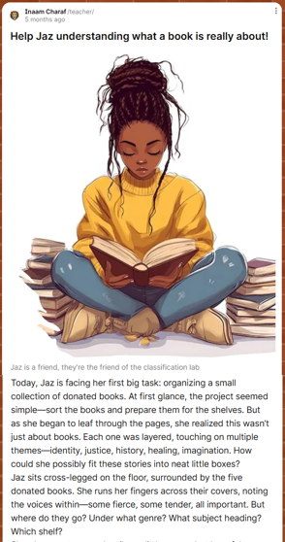
Example: Week 1:
Jaz’s first big assignment
Learning focus: Aboutness & content analysis—Jaz learns how to understand what a book is really about!
Activity: Group working [Padlet activity]

Slide 12

How Jaz supports deeper learning

Slide 13
Learning goals with Jaz
Develop subject analysis skills by working through real-world classification challenges.
01
Deepen understanding of classification systems (DDC, LCC, BDC), Cutters, interdisciplinary tensions, and cultural and ethical biases.
02
Evoke empathy by centering inclusion, multiple perspectives, and lived experience in decision-making.
03
Encourage reflective and affective learning through problem-solving rooted in identity, equity, and ethics.
04

Slide 14
Learning outcomes
Apply classification and subject analysis to assign genres and categories to complex, multi-themed materials.
Justify classification decisions using principles of user-centered logic and ethical access.
Recognize the challenges in organizing content that reflects intersectional identities and non-dominant perspectives.
Demonstrate critical awareness of how identity, neurodiversity, and lived experience shape professional practice.
Propose inclusive strategies (e.g., alternative metadata, signage, and display) that enhance accessibility and discoverability.
Reflect on professional values and communication practices that promote respectful, inclusive work and learning environments.

Slide 15
How Jaz activates each principle in my CRF pedagogy
Storytelling and counter stories
Giving students space to share their lived experiences and counter-narratives
Grounded in realities
Examining and engaging with real-life scenario and incidents
When Jaz gets a headache over classifying Two-Spirit literature, students begin to share their own frustration with misrepresentation—and suddenly the classroom is full of counter-stories
Through Jaz, students are invited to deal with discomfort, ambiguity, and imperfection—welcome to the real live of librarianship

Slide 16
Praxis is central to theory
Centering students’ lived experiences to bridge theory and action
Culturally responsive
Adapting teaching to reflect students’ cultural contexts and identities
When Jaz asks, “Is this where this book really belongs?” students shift from passive learners to active, reflective agents
Through Jaz, students explore how classification—often framed as neutral—is a culturally loaded practice. Jaz’s challenges invite learners to interrogate dominant systems, reflect on their own cultural assumptions, and adapt their decisions to honor diverse epistemologies. This positions classification as both a technical and culturally responsive act

Slide 17
Mutual vulnerability
Fostering shared openness and reflection across cultural differences
Jaz’s courage to seek help, asking questions and say “I don’t know” makes it safe for students to say the same. That’s where transformation begins

Slide 18
References
Berry, T. R., & Candis, M. R. (2013). Cultural identity and education: A critical race perspective. Educational Foundations, 27(3–4), 43–64.
Smith, A., & Seal, M. (2021). The contested terrain of critical pedagogy and teaching informal education in higher education. Education Sciences, 11(9), 476. https://doi.org/10.3390/educsci11090476

Slide 19


