Slide 1
Is Repatriation a Library Issue?
Madison Johnstone

Slide 2

Introductions
Madison Johnstone
Recently graduated with my MLIS from University College Dublin
Undergraduate background in Women and Gender Studies, Political Science, and Anthropology from the University of Toronto
Early-career librarian
mca.johnstone@gmail.com
Notes:
Name (Madison Johnstone)
Recent graduate of University College Dublin, where I got my MLIS
As of right now I am not working as an academic librarian (yet). I’m currently on my job search–if any generous people in the crowd would like to share their advice for someone starting out, I am eager to learn from your stories so please let’s chat after this or at a later time; gonna have my email on the screen
Undergraduate background in women and gender studies, political science, and anthropology which has given me an interdisciplinary lens on the topic today which is repatriation…

Slide 3
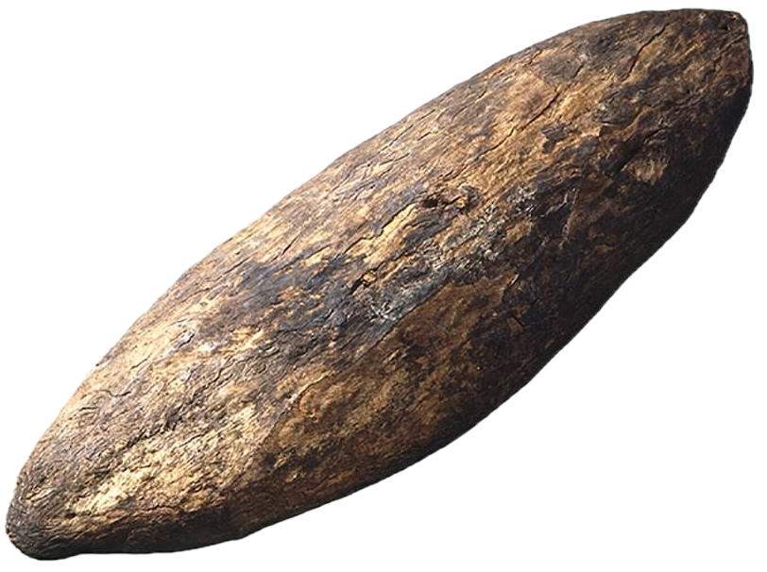
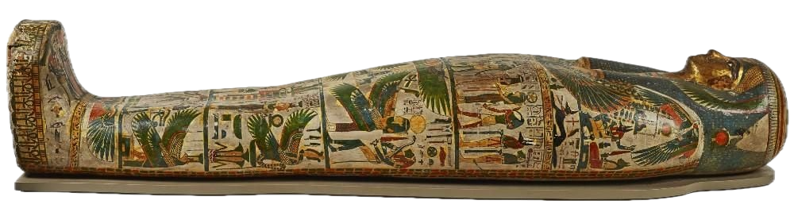
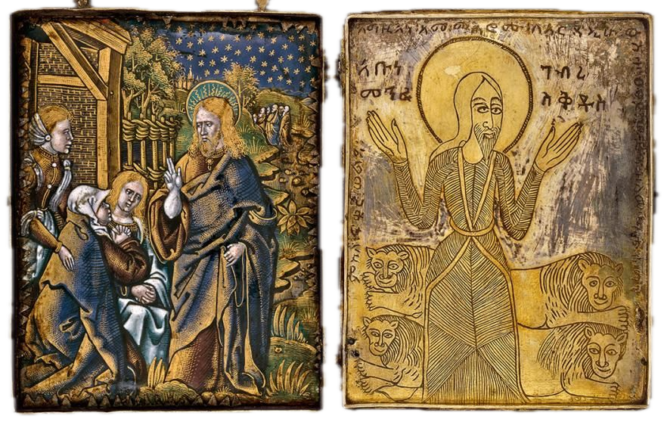
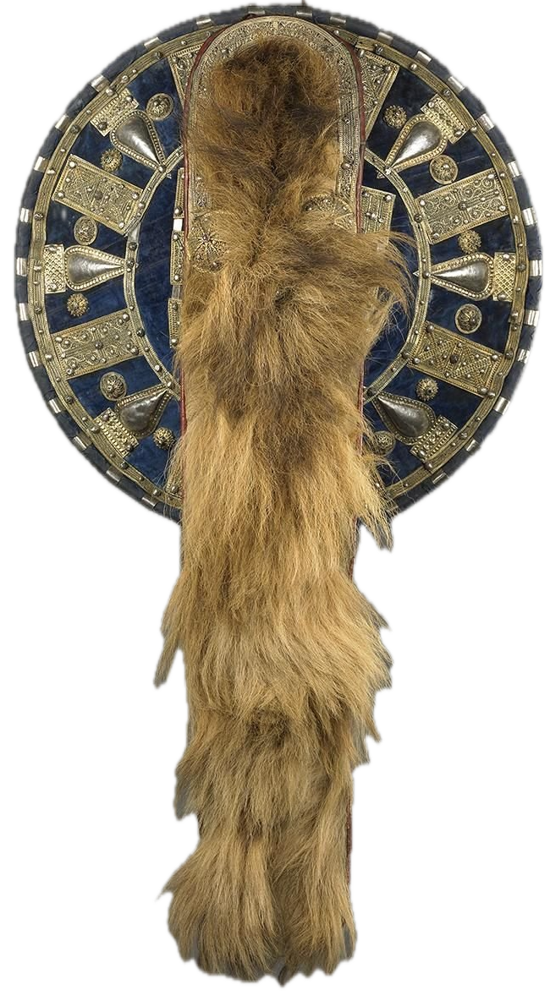
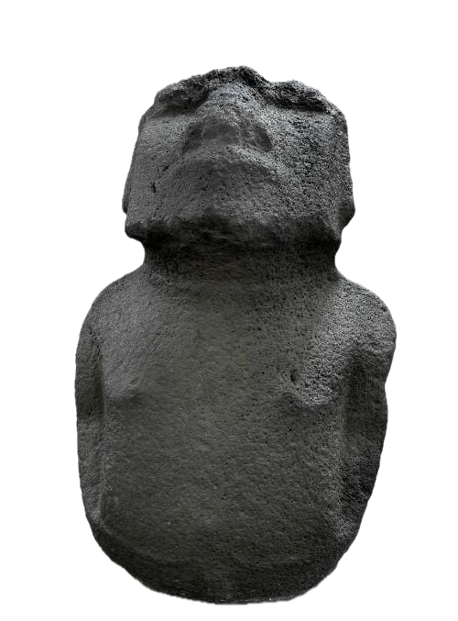
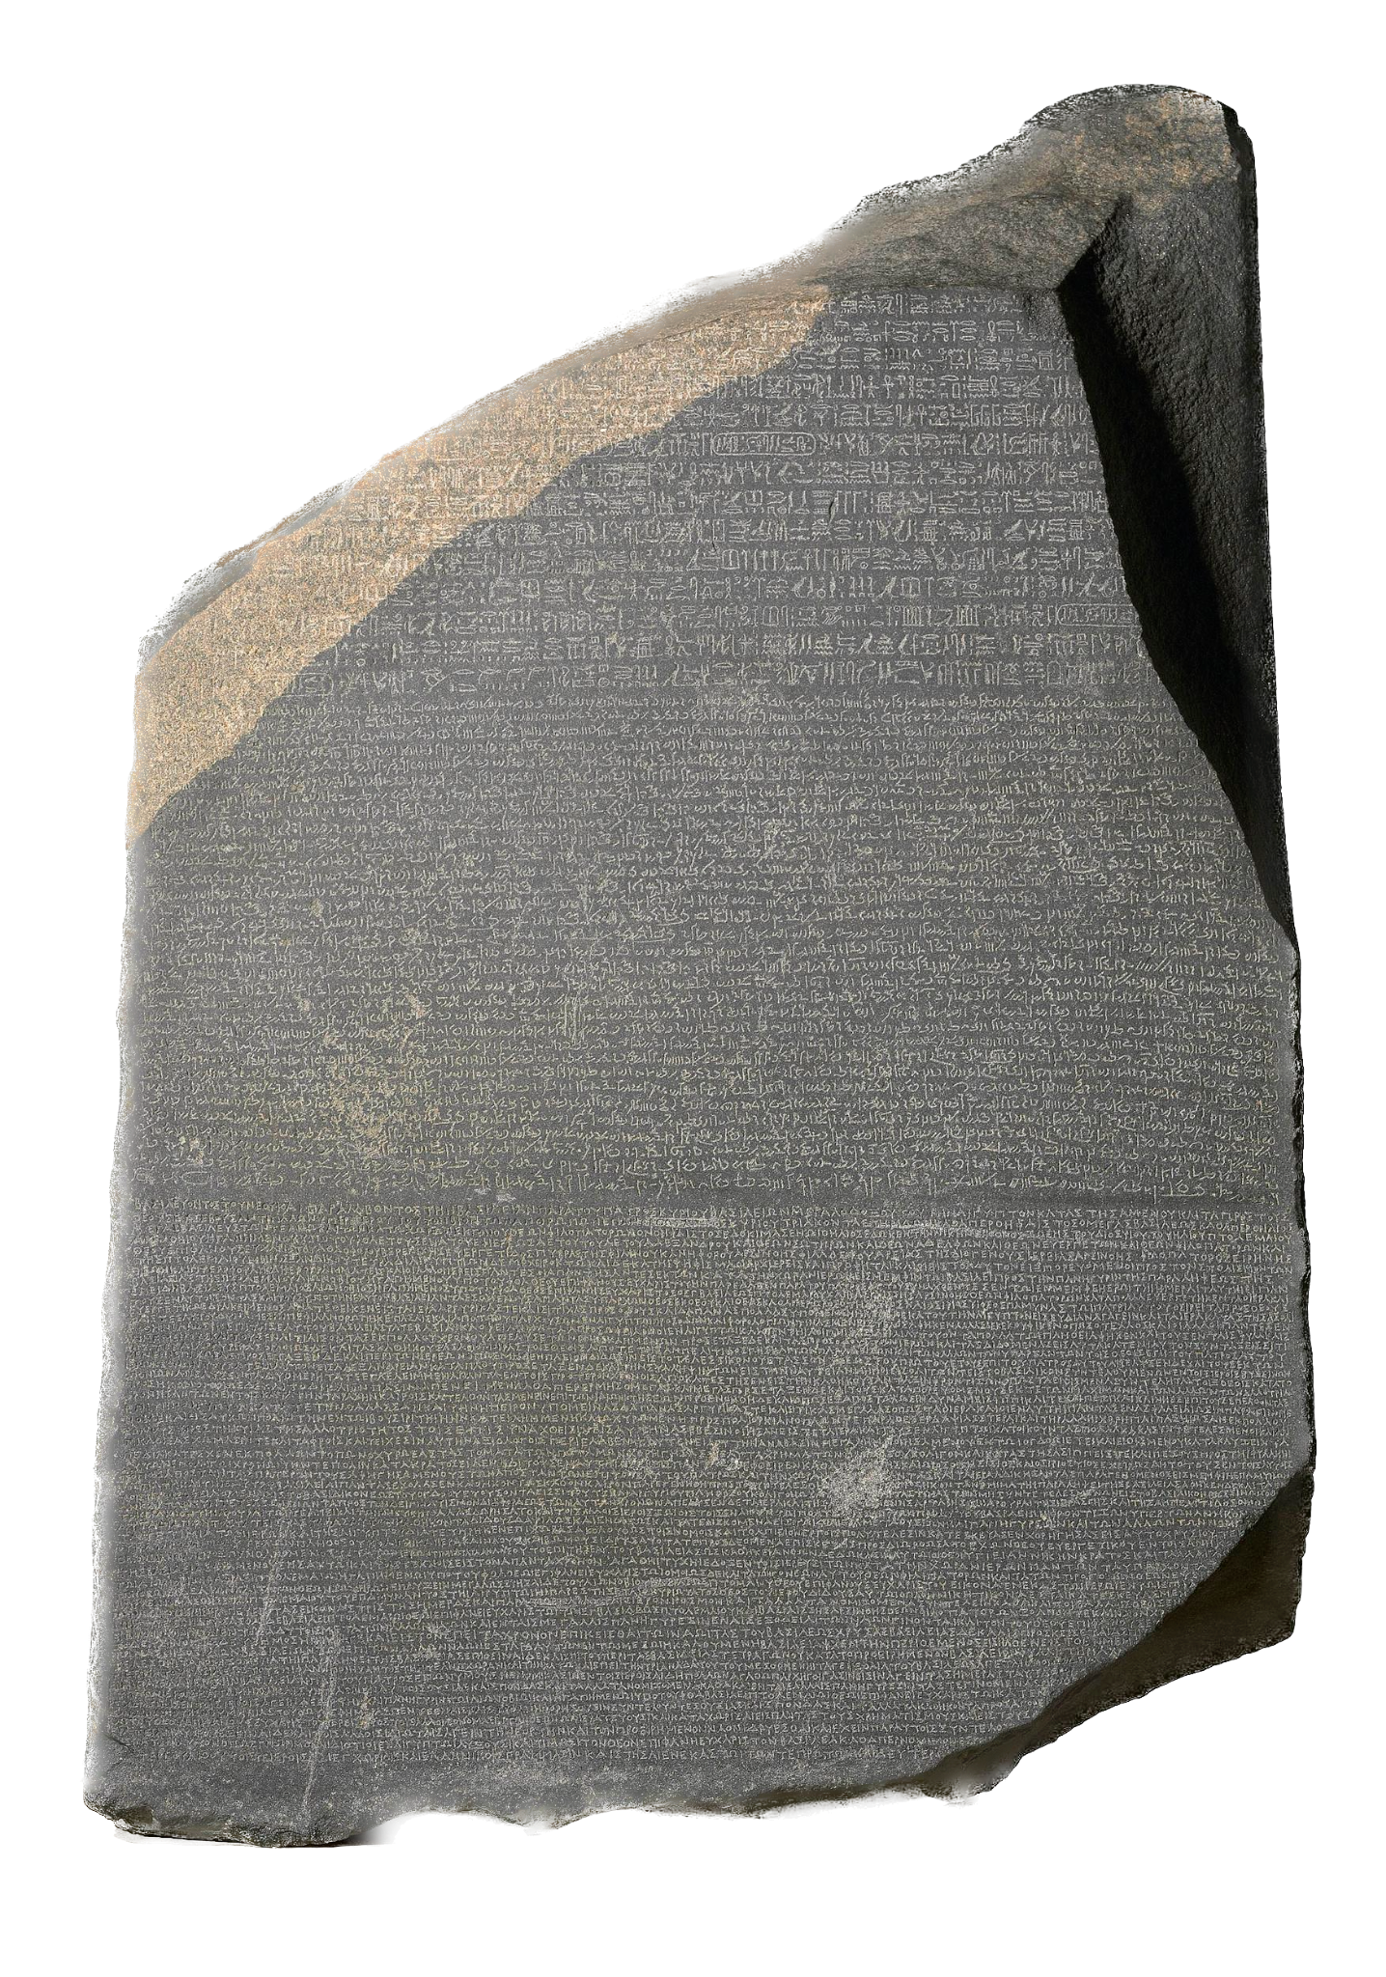
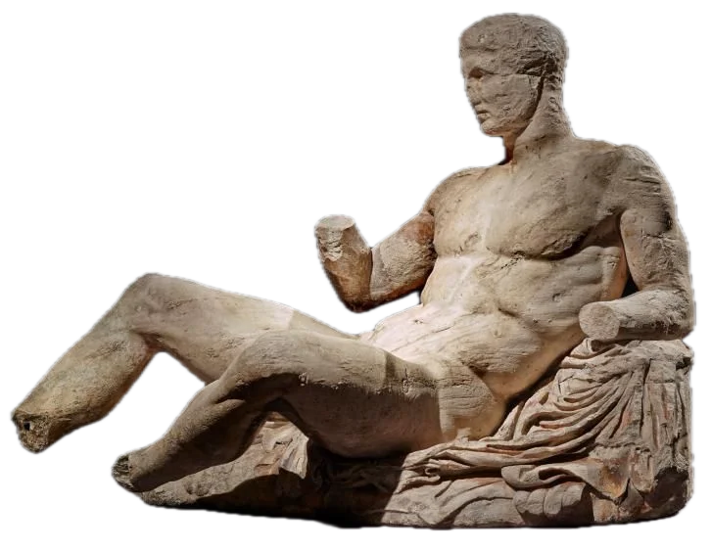
“Is repatriation a library issue?”
Notes:
This presentation is premised on the question, is repatriation a library issue?
This was the topic of my capstone paper in library school and…
Spoiler alert - which is hopefully not too much of a spoiler since this presentation is 60 minutes - Yes, I believe and will argue that repatriation is a library issue that deserves our consideration even though it's commonly thought of in connection with institutions like museums and archives and is rarely talked about in a library context
When the audience thinks of repatriation, what sorts of materials come to mind?
Echo responses but if none list art, artefacts, human remains, maybe rare manuscripts
Evident in popular consciousness but also in the research - most research on repatriation focuses on archival documents and museum artefacts
At this point, if it isn’t obvious already, we are talking about cultural object repatriation - there is a large amount of research on human repatriation, refugee repatriation, and while I think it would be fascinating to see a paper on the overlap between this topic and libraries (if that research exists), that is beyond the scope of what we’re talking about today
When we’re thinking about and writing above and talking about repatriation, less often are we referring to objects that are abundant in libraries, namely books that exist in multiple copies all around the world or in the academic library context, scholarly articles and research

Slide 4
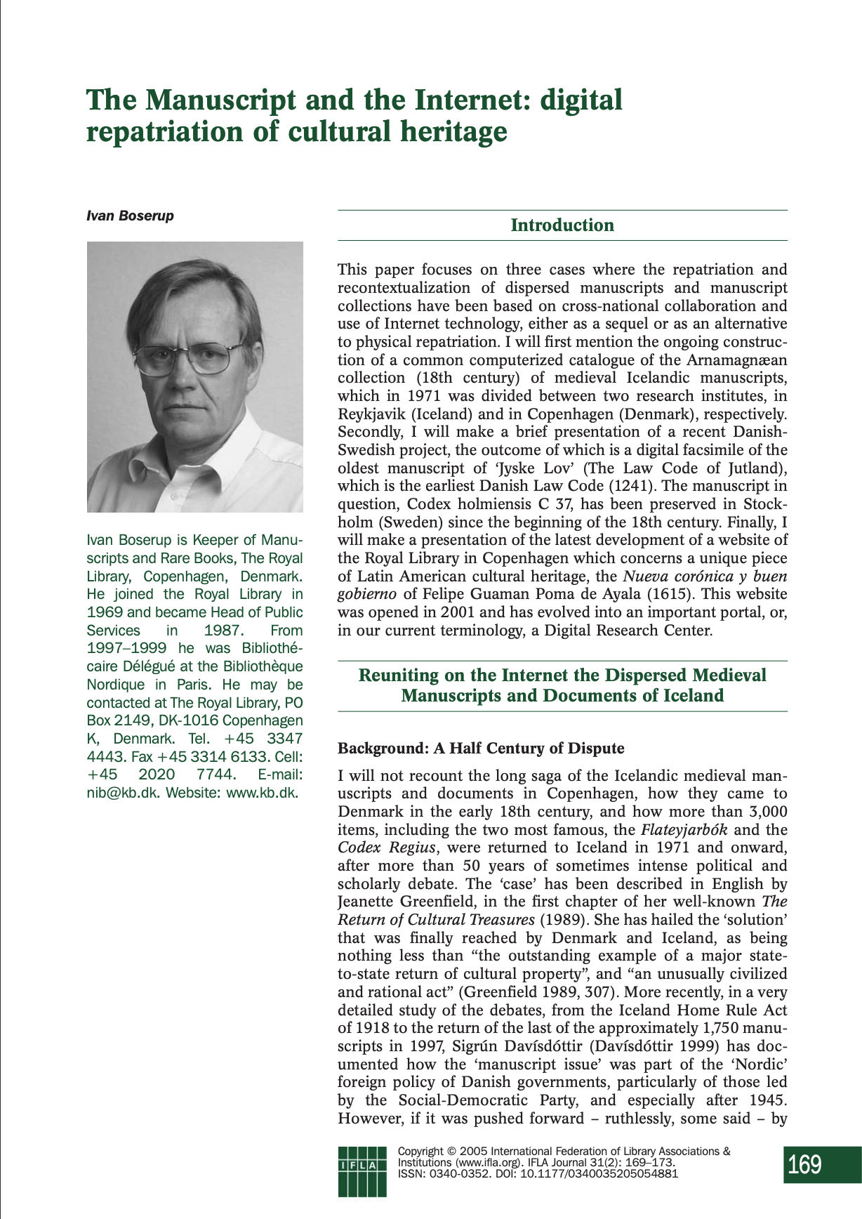
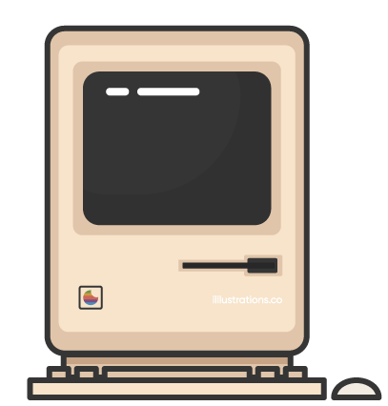
The Manuscript and the Internet
Ivan Boserup
IFLA Journal from 2005
Shows that librarians were thinking about repatriation 20 years ago
Notes:
But actually the idea of repatriation being a library issue isn’t a novel argument
Repatriations have been happening in libraries for a while (as we’ll get into) and librarians have been thinking about repatriation for at least 20 years
For instance, this IFLA article from 2005 shows that 20 years ago librarians were thinking about digital repatriation

Slide 5
Why ask this question?
Why ask it now?
Technology
Present sociopolitical contexts & current research
  Decolonial indigenization: “the wholesale overhaul of the academy to fundamentally reorient knowledge production based on balancing power relations between Indigenous peoples and Canadians, transforming the academy into something dynamic and new.” (Gaudry & Lorenz, 2018, p. 219)
Notes:
So given that, why even ask this question and why ask it now?
Well, two reasons:
One is technology: going back to the article from the age of the early internet, as technology changes, so does our community; our collections become accessible to more and more people. In particular I’m talking about digitization: as collections are digitized, communities are better able to locate items, leading to more repatriation requests
But also I believe now we should connect it to present sociopolitical contexts and current research on decolonization - and that is what I set out to do in my capstone

Slide 6
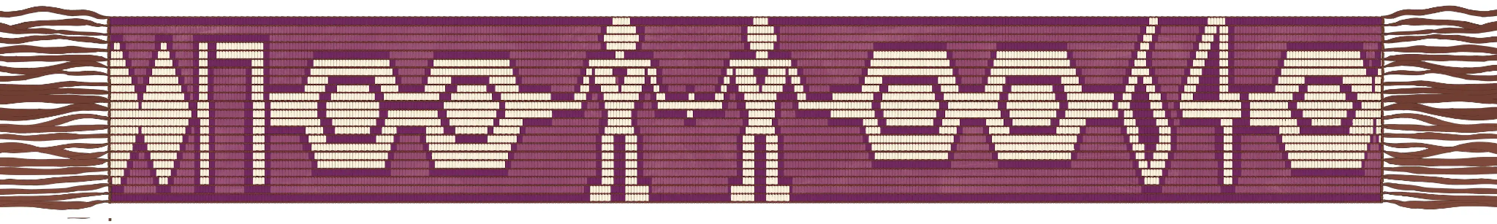
Scope and Positionality
A Fabric of Experience
Treaty relationships (Gaudry & Lorenz, 2018; Loft et al., 2022; Coyle, 2017)
Settler POV
Making explicit the connections between library repatriations, decolonial indigenization, and librarians’ responsibilities as treaty people
Just future relations
The 1764 Great Covenant Chain Wampum Belt
Notes:
Before we go any further, I want to briefly touch on my positionality as a researcher and the scope of this presentation
And because it's the theme of the conference, I’d like to tie in the idea of a fabric of experience
I like to sew, and to me this theme brings up imagery of quilting, where thread is the discourse that binds different cloths, or people and communities, together; it journeys back and forth, kind of like a conversation, like how we as researchers and professionals are all giving and taking to make things whole together - which would be knowledge
This also reminds me of our treaty relationships and responsibilities as treaty people
[expand]
Approaching this work as a settler
Why study topics like repatriation and decolonization from a settler POV? Like why we study masculinities [quote from Bryony video] - to correct an erasure of a group from a discussion that concerns them
Part of having a privilege, like settler–particularly white settler–privilege in Canada, is being a part of systems of discrimination and oppression, benefiting from those systems, yet being able to ignore them and neglect conversations about their impact
That is the scope of this presentation - making explicit the connection between library repatriations, decolonization, and our responsibilities as treaty people, with an eye for how we can translate this conversation into actions that contribute to a more just library future

Slide 7
Terminology
Repatriation (limited)
The transactional return of cultural objects to their nation or state of origin.¹
Restitution
The project of social justice enacted through object return and critique of colonialism.²
Repatriation (expansive)
A process of return to address ongoing legacies from the extensive violence of colonial projects.³
Notes:
Repatriation
Before we start unpacking this I want to clarify some terminology
There is a lot of debate around the word repatriation - It is incredibly compelling how one world can be interpreted to have multiple worlds of meaning
I cannot get into the nitty gritty of this today [but if anyone wants to chat later…]
Repatriation can be defined (in its most limited form) as the transactional return of cultural objects to their nation or state of origin (Roehrenbeck, 2010; McKeown, 2020; Bradley, 2023; Rassool & Gibbon, 2024)
The term repatriation has garnered criticism for its limited capacity, patriarchal and state-centric roots, and a lack of connection to the larger socio-political and emotional politics surrounding return (Rassool & Gibbon, 2024)
Restitution
Another word of note is restitution, which can be defined similarly and is often used interchangeably with repatriation (Rassool & Gibbon, 2024)
Restitution signifies the broader project of social justice enacted through not only object return, but a critique of the systems that historically engendered object appropriation in the first place with an emphasis on the idea of reinstating rightful ownership
So which is it?
Terminology debates are ongoing
But more expansive interpretations of repatriation (particularly those deployed in anthropology) do fold in a lot of the elements ascribed to restitution, including “a process of returning ancestors and culturally significant belongings, relations, and kin, including language materials, representations of culture, data, biological specimens and seeds [to address] ongoing legacies from the extensive violence of colonial projects of erasure and the possession of Indigenous peoples” (Anderson and Atalay, 2023, p. 1)
And whether interpreted in its limited or expansive form, repatriation almost always connotes an understanding of improper acquisition, given the historical link between object extraction and histories of colonialism
I think whether or not we want to include a critique of the systems that historically engendered object appropriation in the first place with an emphasis on the idea of reinstating rightful ownership is up to us as interlocutors - I’m not a fan of changing the term (I think repatriation and restitution can stay related concepts)
So I will be using repatriation because it is the more popular term, other scholars do use it in its expansive form, and it’s important to me that people are invited into this conversation so that we can grow, get people on board, and hopefully if necessary change some minds, and I think using the popular term is good for that

Slide 8
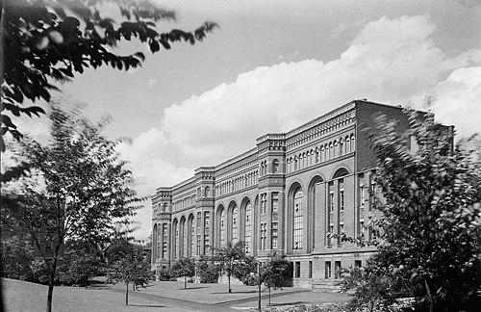
A Brief Introduction to Colonialism and Museums
“Spoils of war” attitude towards the looting of cultural objects (Roehrenbeck, 2010)
Museums shape memory and identity (Procter, 2020)
Construct worldviews and normalize power relations
The ROM, 1922, facing “Philosopher’s Walk”
Notes:
Moreover I think its important to remember that second half of the definition…return “[to address] ongoing legacies from the extensive violence of colonial projects of erasure and the possession of Indigenous peoples” (Anderson and Atalay, 2023, p. 1) and libraries’ participation in these projects
More context about colonialism, libraries, and extraction…
Libraries all over the world have been engaged in knowledge acquisition and classification, processes we know are not neutral
Like the Nazis and the BL, Canadian libraries engaged in a process of extraction and collecting at the expense of Indigenous communities
When we are thinking about extraction, we can pull from this imagery of an excavation
So what about when the books aren’t rare, or when the object isn’t a book at all, but its still manifest of this historical relationship?

Slide 9

Libraries and Colonialism
Universalist knowledge systems, classification schemes, and cataloguing vocabularies (Crilly & Everett, 2022)
Displacing Indigenous information systems with colonial ones
Extraction
“Within our research institutions, there have been and continue to be countless histories of researchers… who have engaged with Indigenous communities, only to take Indigenous Knowledges, important objects, tissue samples, and the literal bodies of ancestors, and return to their institutions to store these Knowledges, materials, and people in libraries, archives, and museums.” (Wong, 2024, p. 2)

Slide 10
“But repatriation concerns (rare) object return…”
Notes:
So is repatriation a library issue?
While repatriation as defined by Anderson and Atalay includes explicit reference to representations of culture and data as objects subject to a process of returning, it may still be hard to see repatriation as a library issue
In popular understanding, repatriation concerns object return. Most libraries, barring special collections, deal with books, films, journals, and research articles that exist in multiple copies.
Moreover, given the prevalence of the digital library in the 21st century, the information contained in libraries can effectively be everywhere at once.
If the majority of most library collections are not rare materials, can repatriation really be considered an profession-wide issue?
​​Frankly put, still yes - instances of rare materials repatriations (or repatriations that more closely align with a limited definition of the term) have been taking place in library sphere for at the very least five years
I’m gonna jump into two examples of those now
The first two are from outside of the Canadian context

Slide 11
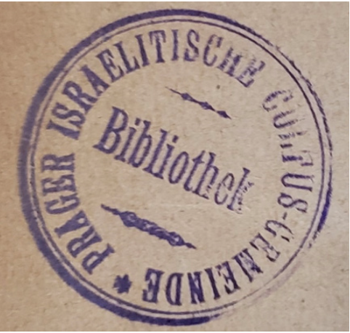
UCLA’s repatriation to the Jewish Museum Prague (JMP)
Jewish Religious Community Library (JRCLP) → JMP after WWII
UCLA’s Jewish Studies Library receives repatriation request from JMP in 2021
Returns 6 manuscripts from its collection
Source: Mizrachi & Bušek, 2023
A Pre-WWII Ownership Stamp of the
Jewish Community Library in Prague
Notes:
An example of physical repatriation occurring squarely in the academic library space comes from the University of California Los Angeles (UCLA) library’s 2021 repatriation of six books looted by the Nazis from the Jewish Religious Community Library (JRCLP) in Prague during the Second World War (Mizrachi & Bušek, 2023).
Some context: Prior to Nazi confiscation, the JRCLP was one of the richest Jewish community libraries in Europe, its collection numbering nearly 30,000 items in 1939 (Mizrachi & Bušek, 2023). [what did this number shrink down to?]
By 2017 the JMP was still missing 10,000 items and revamped its search for the remaining items from the JRCLP’s original collection (Mizrachi & Bušek, 2023).
​​Four years into JMP’s search, the UCLA Jewish Studies libraries received a message from Ivan Kahout, JMP’s curator, requesting three items in the library’s collection.
Kahout explained that the books bore the JRCLP’s pre-war ownership stamp and accession numbers and asked that they be returned to the JMP (Mizrachi & Bušek, 2023). Following Kahout’s initial request, the curator found two more items in UCLA’s collection bearing the stamp and an additional sixth item was found by a university librarian (Mizrachi & Bušek, 2023).
The UCLA librarians set out to repatriate the items, first verifying their provenance and checking the texts for completion and legibility before packaging, insuring, and shipping the items according to the standards for rare books (Mizrachi & Bušek, 2023).
Following this repatriation and in anticipation of future requests of a similar nature, the UCLA library established an official workflow for repatriating books that includes a moral imperative for librarians to know where their items came from and how they came to be in their library’s collection (Mizrachi & Bušek, 2023).
So this establishes a proactive precedent for repatriations in libraries

Slide 12
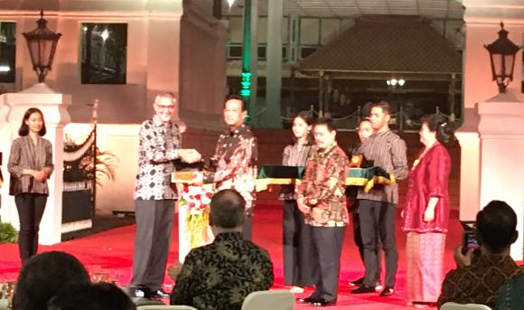
The British Library’s digital repatriation of the Yogyakarta Kraton Manuscript Collection (YKMC)
Taken during the British assault of the palace of Yogyakarta in June 1812
Celebrated as “digital return”
Physical manuscripts remain in possession of BL
Sources: Gallop, 2018; Valluri, 2024
March 7, 2019: British Ambassador to Indonesia presents digital images to Sri Sultan Hamengku Buwono X
Notes:
The British Library’s (BL) digitization of the Yogyakarta Kraton Manuscript Collection (YKMC) offers an example of digital repatriation in the library sphere.
Officially the national repository of the United Kingdom, the BL is one of the largest libraries in existence with a collection of roughly 170 to 200 million items from all over the world (“British Library,” n.d.).
Amongst the collection are 500 manuscripts from Indonesia, nearly 300 of which are from the island of Java (Gallop, 2018a; Valluri, 2024). A subset of these Javanese manuscripts originate from the palace of Yogyakarta.
The YKMC’s acquisition by the British is clear, with the library itself stating that the manuscripts, “were taken during the British assault on the palace of Yogyakarta in June 1812” (Gallop, 2016, para. 1).
In March of 2018, just over 200 years after the siege, the BL announced its intention to digitize the YKMC, with a plan to upload the images online and present digital copies to the Archives and Libraries Board of Yogyakarta and the National Library of Indonesia (Gallop, 2018b). In its initial rollout, the BL planned to digitize 75 manuscripts (Gallop, 2018b).
The library reached its first target and in 2019 the British Ambassador for Indonesia handed the digital master copies of the manuscript images to the Sultan of Yogyakarta (Valluri, 2024). Indonesian news outlets celebrated this “digital return of [their] culture” (Valluri, 2024).
In addition to the Indonesian handover, copies of the manuscripts were made publicly available online for researchers from all over the world to access through the BL’s website (Gallop, 2018b).
The physical copies of the manuscripts controversially remain in the possession of the BL (Valluri, 2024).

Slide 13
So what?
Outside of the Canadian context
Technology: digitization will lead to more repatriations (Mizrachi & Bušek, 2023)
Varying levels of restitution
Rare book repatriations happening in libraries around the world
But what about when the book isn’t rare or the information isn’t a book at all?
Notes:
Two different types of repatriation - one physical, one digital
Varying levels of restitution - in the BL example, the original manuscripts stay with the British, doing relatively little to address and rectify the British appropriation of the manuscripts
While these case studies demonstrate that rare object repatriations are within the realm of libraries, they don’t really address the question I raised earlier: If the majority of most library collections are not rare materials, can repatriation really be considered an industry issue?
Based on the evidence I’ve shown so far, library repatriation is kind of a fringe issue - rare, like the materials it concerns
Recall the expansive definition of repatriation from Anderson and Atalay: “a process of returning ancestors and culturally significant belongings, relations, and kin, including language materials, representations of culture, data, biological specimens and seeds [to address] ongoing legacies from the extensive violence of colonial projects of erasure and the possession of Indigenous peoples” (Anderson and Atalay, 2023, p. 1) a larger amount of library materials become relevant to this process of return
Are our cataloguing and classification systems not representations of culture? Is our research not data?

Slide 14
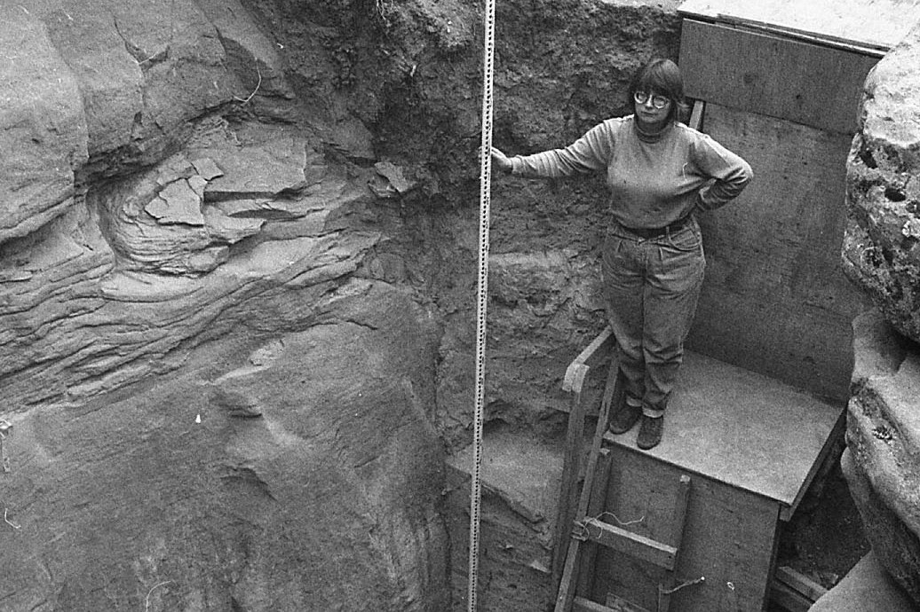
Simon Fraser University Library’s repatriation to the Dane-zaa First Nations
Tse’k’wa is a sacred cave near the Peace Valley
1974-1991: teams of archaeologists from SFU excavate Tse’k’wa
Record were kept at SFU Library
Dane-zaa First Nations established the Tse’k’wa Historic Site in 2012
SFU digitally repatriated the research and physically repatriated the artifacts in 2024
Sources: SFU News, 2024; Tse’k’wa, 2024
An image of the SFU excavation of Tse’k’wa in 1991.
Notes:
Such is the case with Simon Fraser University (SFU) in a 12-year-long process concerning artifacts and research documents from the institution’s Tse’k’wa excavations.
Also an example of physical and digital repatriation occurring in tandem
From 1974 to 1991, teams of archaeologists from SFU excavated Tse’k’wa, a cave formation in what is now known as British Columbia (BC) sacred to the Dane-zaa Nations as it represents a connection to their early ancestors with evidence of human habitation and Dane-zaa cultural activity dating back to the end of the last ice age (SFU News, 2024; Tse’k’wa, 2024a; Tse’k’wa, 2024b).
Records of information from the excavations were archived at the university, comprising in total fifty years of archaeological knowledge and scholarship including field notes, research materials, maps and photographs, data sets, and post-excavation analyses (Tse’k’wa, 2024a).
In 2012, three Dane-zaa First Nations acquired the land containing Tse’k’wa, establishing the Tse’k’wa Historic Site and opening up discussions about repatriating SFU’s materials (Tse’k’wa, 2024b).
In February of 2024, the university’s archive was made publicly available online by the SFU Library through the university’s institutional research repository, Summit (Tse’k’wa, 2024a). Prior to this, the research collected through SFU’s excavations had only been published in academic formats, making it “largely inaccessible to the First Nations and to the general public” (Tse’k’wa, 2024a, para. 9).
By digitising the archive, the research gathered from Tse’k’wa was ‘returned’ by making the materials digitally available to all. This move was hailed as the “first step” (SFU News, 2024, para. 6).
Shortly following the digital repatriation, the Tse’k’wa National Historic Site received official repository status from the BC Archaeology Branch and artifacts that had been kept by the university were also returned in a physical repatriation funded by the First Peoples’ Cultural Council (Tse’k’wa, 2024b).
At present, the entire Tse’k’wa collection remains in the Dane-zaa Nations’ possession at the Tse’k’wa National Historic Site (Tse’k’wa, 2024b).

Slide 15
The University of Toronto’s repatriation of The Sacred Scrolls of the Southern Ojibwe (1975)
A settler-written book containing “lifesaving and sustaining” Anishinaabe cultural information (Wong, 2024, p. 10)
Widely purchased worldwide
After consulting with Dr. Debby Wilson Danard, Wong determined having the text stored and publicly available at the library was inappropriate
Uses “restitution” in the text (p. 16)
Source: Wong, 2024
Notes:
Bonus case study - original research included three case studies but since coming home and updating it, and with the help of my OLA mentor Tina Liu, I was able to add another case study to the research

Slide 16
So what?
Expansive definitions of repatriation include types of information beyond rare objects
  Data
  Knowledge
  “Representations of culture” (Anderson & Atalay, 2023, p. 1)
The library is not always the right institution to store and disseminate certain information (Wong, 2024)
The library is not neutral

Slide 17
Looking to the Future: Canadian Libraries and Repatriation
Treaty-based decolonial indigenization (Gaudry & Lorenz, 2018)
  What is included
  What is excluded
  Indigenous nations should always have “the capacity to sustain their lives and flourish as nations” according to the Treaty of Niagara, 1764 (Loft et al. 86-97).
Proactive approach to repatriation (established workflows)
Generous response to repatriation requests
MLIS education

Slide 18
What do you think?

Slide 19
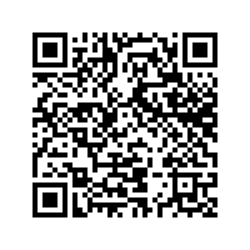

Thank you!
References!
Madison Johnstone
mca.johnstone@gmail.com
Notes:
To ask if repatriation is a library issue therefore is not a simple question of whether or not special collection repatriations should be on our radar, nor is it an implication that if and when requests for return crop up, librarians should respond sympathetically. It requires us to confront how colonialism has and continues to shape the library, to consider the library as an inherently biassed institution like the museum, and to that end, to decide what we want the library to stand for. Wittingly enacting expansive repatriation necessitates an admission of improper acquisition (which we can also understand expansively) caused by colonial violence.

