Slide 1

Beyond Boundaries: Advancing Shared Print Across Canada with North/Nord
Canadian Association of Professional Academic Librarians Conference
June 2, 2025
Katya Pereyaslavska (M.A., M.I.)
North/Nord Coordinator
North: the Canadian Shared Print Network/ Nord: Réseau canadien de conservation partagée des documents imprimés

Slide 2
Shared Print in Canadian Context
What is shared “print”?
A set of shared physical collections developed in partnership across organizations (universities, colleges, public libraries, government libraries etc) to ensure long term access to resources at regional or national level.
Involves partnerships & agreements, collections & metadata work and stakeholder coordination to identify and register shared print collections with OCLC Shared Print Registry.
Some of the larger regional and national shared print programs/facilities which exist across Canada
TriUniversity Group of Libraries Annex (includes a facility)
COPPUL SPAN (distributed model)
Keep@Downsview (includes a facility)
Partenariat des bibliothèques universitaires du Québec Shared Preservation Program (SPPPC is a distributed model)
HathiTrust (US-based, but some Canadian libraries are retention holders)
North: the Canadian Shared Print Network/ Nord: Réseau canadien de conservation partagée des documents imprimés (includes access to 4 facilities across membership)

Slide 3
National Level Coordination: North/Nord
https://northnordsharedprint.ca/
Established in 2021 and governed by a national steering committee with representatives from the regional academic library consortia and shared print programs including:
Canadian Association of Research Libraries (CARL)
Canadian Urban Libraries Council (CULC)
Council of Atlantic Academic Libraries (CAAL)
Library & Archives Canada (LAC)
Ontario Council of University Libraries (OCUL)
Partenariat des bibliothèques universitaires du Québec (PBUQ)
The Council of Prairie and Pacific University Libraries (COPPUL) HOSTING ORG
Membership Growth
October 2022: 21 participating libraries
October 2023: 31 participating libraries
October 2024: 35 participating libraries
Retentions: Projects in Three Streams
For Government Documents we sought commitments on 17,672 titles for up to 5 titles.
For Indigenous Works Stream we are working with a dataset of publications Curated via COPPUL (~1330)
For Canadiana projected number of retentions is in the thousands, firm numbers will be available soon (projections exceed 100k)

Slide 4
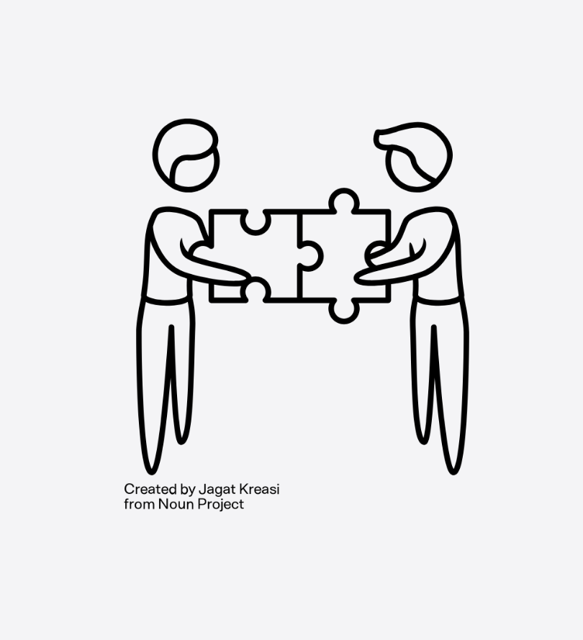
National Level Coordination: North
1: Government Documents
This group just published the Stable Print Repositories of Canadian Government Documents to capture the national landscape of Federal documents in an effort of improving national level coordination and improving discoverability of this content by libraries to build confidence and support weeding where members can.
Dream of a Canon of Government Documents which could help us develop more comprehensive strategies in working with these collections. New partnership with DSP.
Working through retention commitments which have been assigned and are now mostly confirmed.
Title List is available on our website and in this slide.

Slide 5
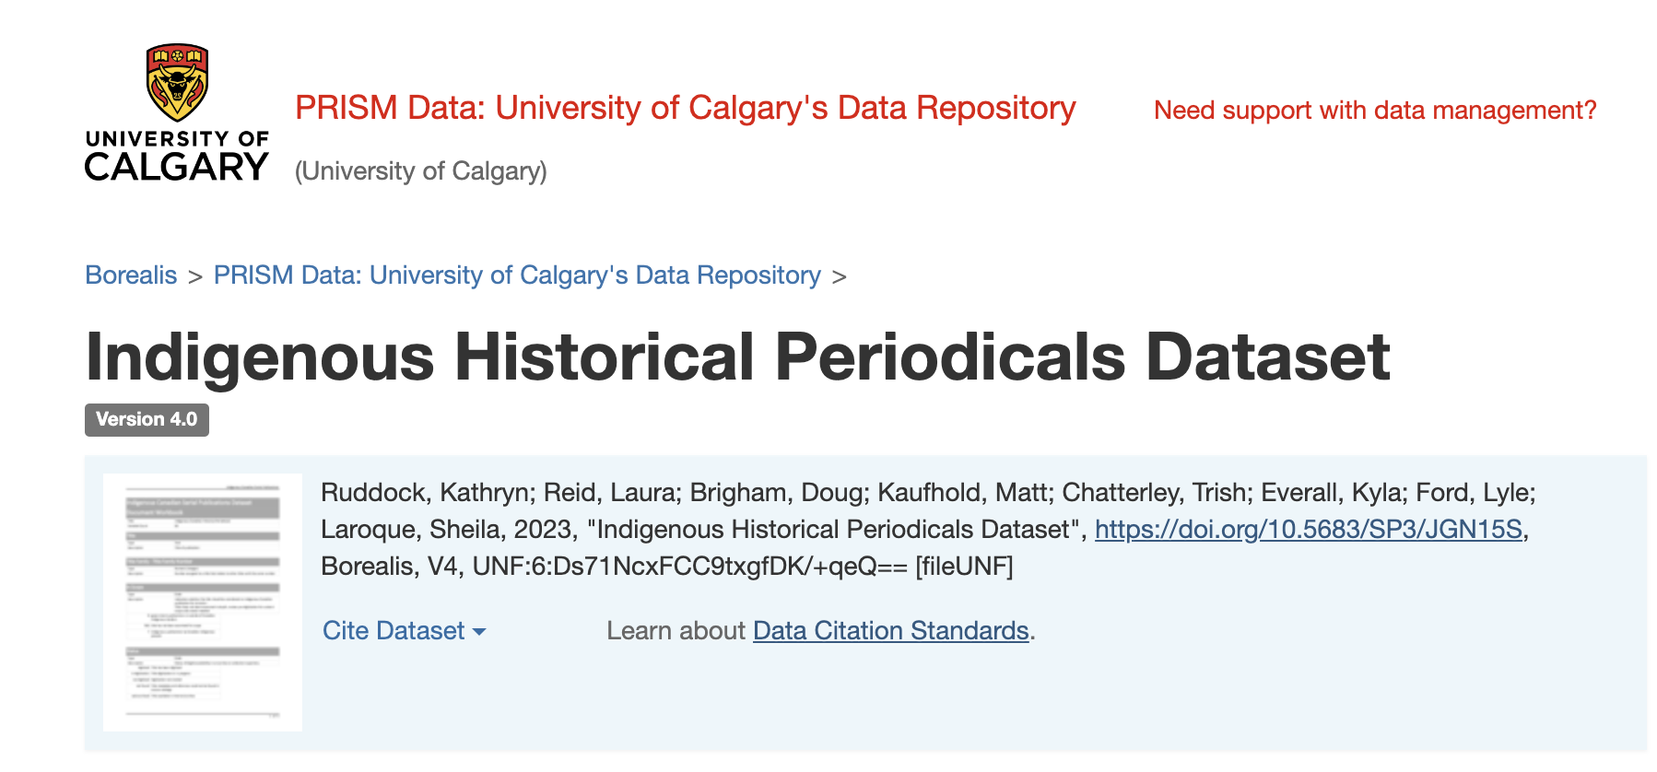
National Level Coordination: North
2: Indigenous Works
The work guided by the Indigenous Works Stream is a part of the broader charge of North/Nord to identify and preserve Indigenous Works across Canada, collaborating with partners (incl. NIKLA) and critical stakeholders to identify Indigenous materials across Canadian institutions, ensure their long-term retention and print conservation.
There are concerns regarding disappearing content across Canada and strong commitment to identify and keep safe valuable cultural resources which are authored by or are about Indigenous communities.
Libraries are assuming a temporary stewardship role in coordinating activities to ensure that this content is safe
Phase One included collaborating with the Indigenous Historical Publications Working Group (IHPW) which was tasked with improving discovery, access to and preservation of publications by and about Indigenous communities. These publications included newspapers, newsletters and various forms of gray literature and this project resulted in a publication of a dataset in Borealis which included ~1330 unique titles: https://borealisdata.ca/dataset.xhtml?persistentId=doi:10.5683/SP3/JGN15S
This is our first project.

Slide 6
National Level Coordination: North
3: Canadiana
Work continues on the Canadian University Press (CUP) publications overlap analysis of the Association of Canadian University Presses (ACUP) titles.
We anticipate that participating libraries will be informed of the results of the analysis mid-year.
Outreach activities to identify non-ACUP presses has begun as have exploratory conversations about the possibility of matching print versions with their electronic counterparts in the ACUP collection.
Digital Surrogates
North/Nord is very interested in finding solutions to link print & digital surrogates to create a central space for researchers and library staff who can view retention commitments in one place having a clear understanding of how to access these materials, where and in which format they may be available.
Leading & Educating
North/Nord continues to facilitate education and expertise development across shared print programs in Canada. We will continue to connect partners, share information about best practices in shared print and document the history behind this momentum in Canada. Please watch out for our soon to be released North/Nord Primer which will provide historical context and a detailed timeline of our activities to date.

Slide 7
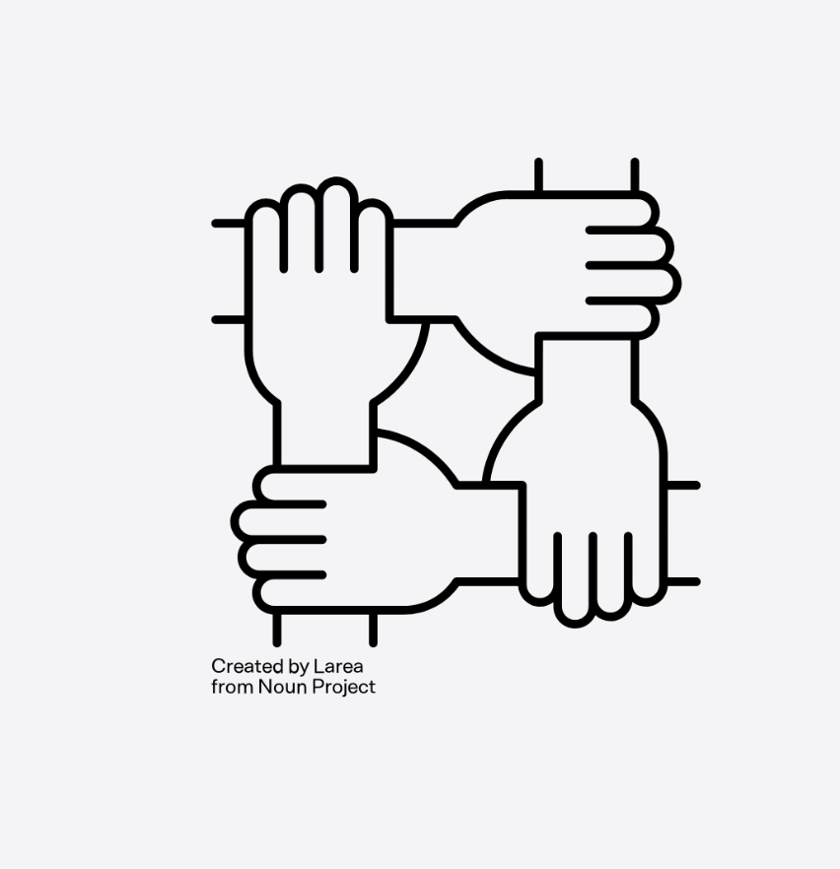
Experts We Work With
Professional Librarians across the following disciplines
Collections
Metadata
Subject Specialists (Gov Info, Indigenous Matters..)
Managers & Senior Leaders
Library Consortia

Slide 8
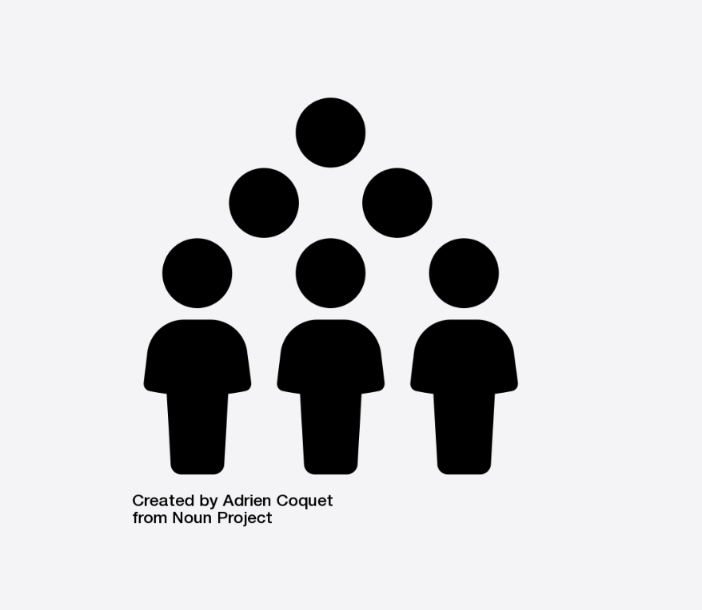
Opportunities for Engagement
Working Groups
There are three streams which divide North/Nord activities across the network. Each stream has a dedicated working group, some with subgroups.
Groups have some space for additional members depending on your skillset!
Researcher in Residence Program
North/Nord is piloting a new program to work more closely with researchers interested in advancing shared print activities across Canada. If you have a research leave coming up or are working on research papers which may be of particular relevance to shared print or more broadly collection analysis & the use of AI tools, please get in touch for a chat!
Grant Writing & Funding Applications
If there are interesting funding opportunities for a shared print partnership project we would love to chat with you!
Institutional Membership
Join us as a new North/Nord member, there isn’t cost associated: https://northnordsharedprint.ca/about/

Slide 9
Building a Robust Ecosystem Through Interdisciplinary Collaboration
Professional Librarian Networks & Shared Print
Unique opportunity to reimagine how libraries collaborate across sectors in Canada and build sustainable pathways across regions & national level.
This presents an opportunity to foster collaboration across traditional silos and cultivate interdisciplinary teams of professional librarians dedicated to advancing shared print initiatives in Canada. By shaping our work experiences to diversify who we work with and working in emerging areas, we have a unique opportunity to enrich our career paths.
leveraging expertise in collection management, applying project management methodologies, and engaging in strategic development, these teams can drive innovative, sustainable solutions to support the long-term stewardship of scholarly resources.
The theme of this conference, “The Fabric of Librarianship: A Patchwork of Experience,” underscores the importance of expanding our professional expertise as academic librarians. Shared print initiatives serve as a compelling platform for this growth—offering an interorganizational, collaborative, and interdisciplinary environment that is well-positioned to integrate emerging technologies and advanced methods of collection analysis.
It is a space that invites innovation and forward-thinking practice.

Slide 10
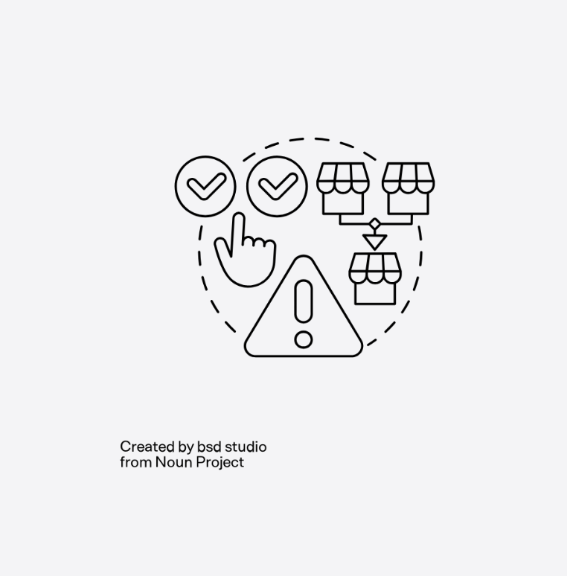
Opportunities for Development & Growth
Consistency & Standards
Setting standards and distributing this work across organizations
Sharing Successful Workflows
Developing project pilots and sharing workflows widely
Tackling Obstacles
Solving problems which hold shared print back and sharing solutions widely across the community
Building Bridges
Linking networks and other projects and sharing working models
Connecting Resources
People, money and ideas - none of us have all three things!

Slide 11

Hot Topics
Areas of particular interest to North/Nord streams
ILL (resource sharing is a major underpinning of shared print) & opportunities for sharing rare collections.
Interoperability between ILL systems & changes in ILL landscape. Vendor driven networks are going to take precedence very consortial networks, this may pose a concern to shared print.
AI & Collection Analysis Tools (as alternatives to Greenglass)
Development of educational resources about shared print for faculty and students
Creating opportunities for Indigenous Communities to guide the development, preservation and access practices around Indigenous works held across Canadian libraries.
Developing the Canon of Government Docs in Canada going as far back as 1927.
Embedding shared print in all aspects of collection management
If you have project ideas, please submit them directly to us using our online form: bit.ly/4myMq5f

Slide 12

Thank You!
Katya Pereyaslavska (M.A., M.I.)
Network Coordinator
e: kpereyaslavska@coppul.ca
Shared Print Archiving Network Program
Council of Prairie and Pacific University Libraries (COPPUL)
https://coppul.ca/collections/shared-print/
North: the Canadian Shared Print Network/ Nord: Réseau canadien de conservation partagée des documents imprimés
https://northnordsharedprint.ca/
ORCID: 0000-0002-1381-1991
To hear how to pronounce my name: https://namedrop.io/katyapereyaslavska1

